Slide 1
PPT Accessibility
Use white background color.
Use Arial, Calibri, or Verdana font (sans serif font); Use 12-14 point or larger
Keep it simple. Limit text and volume of content. White space is good.
Use images and graphics with text description nearby or as alt text (see pages 2 and 3 on how to do this).
Each slide should have a unique title.
Do not use transitions and animations.
Try to avoid inserting text boxes. If you do use them, check the slide reading order.
Embedded video? It should be captioned. Embedded audio? Include a transcript. Send the links to videos to your coordinator to upload to Echo for captioning.
If you use YouTube videos (or any outside videos), it must already have captions and you have to verify for accuracy.
Include links to videos on the slide (do not imbed).

Slide 2
Create Alternative (alt) text for Images
To create alt text for images and graphics:
Right-click the image
Select Format Picture
Click Size & Properties (the arrows icon)
Select Alt Text
In the Description (not the Title), write a short description of the content of the image.
The description depends on the context.
If the image is decorative, leave blank.
Go ahead, try this one!

Slide 3
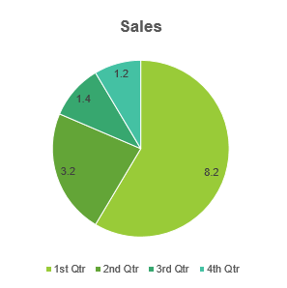
Alt Text for Complex Images
For complex images and graphics, use alt text and either:
Write the full description next to the image
Hyperlink the image to a web page with text description
Write the long description in the presenter notes (bottom of slide)

Slide 4
Create Accessible Tables
To create accessible tables in PPT:
Use simple table structure.
One header row/column
No split or merged cells
No blank rows/columns
Identify the header row (and/or column).
Click inside the table
In the top Table Tools tab > Click Design
Make sure Header Row box is checked
Week | Topic | Assignment
1 | Sandy | Project A
2 | McKenzie | Project B
3 | Klamath | Project C

Slide 5
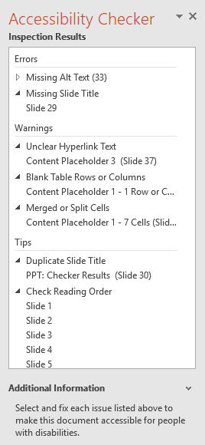
Use PPT’s Accessibility Checker
File > Check for Issues > Check Accessibility
-or-
Review Tab > Check Accessibility
It will alert you to
Errors
Warnings
Tips

Slide 6
Session Title
Presenter, Title, and Date

Slide 7
Disclosures/Conflict of Interest

Slide 8
Session Objectives

Slide 9
Your regular presentation starts here

