Slide 1
Me and My Doctor
Module 4

Slide 2
BEFORE: How to Prepare for My Doctor Appointment

Slide 3
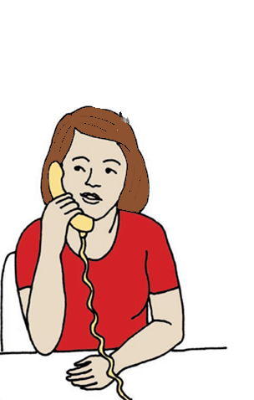
Making an Appointment
The first step before going to your doctor is to make your appointment:
Find a time that works for both you and your doctor.
Know where your doctor is located.
Let your doctor know if you need language services.
Ensure the doctor’s office is accessible and that they can accommodate your needs.
Yes, Thursday at 2:00 pm sounds great!
Hi
Hi, I need to make an appointment.

Slide 4


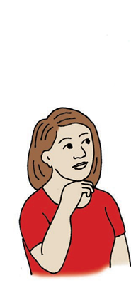

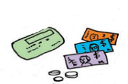

Finding Transportation
Determining how you will get to and from your appointment and taking time to plan ahead is important.
If you take public transit, remember your transit pass or fare money.
If you have someone drive you, make sure you schedule with them ahead of time.
If you plan to travel by car, ask your doctor’s office about parking options.

Slide 5
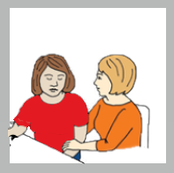
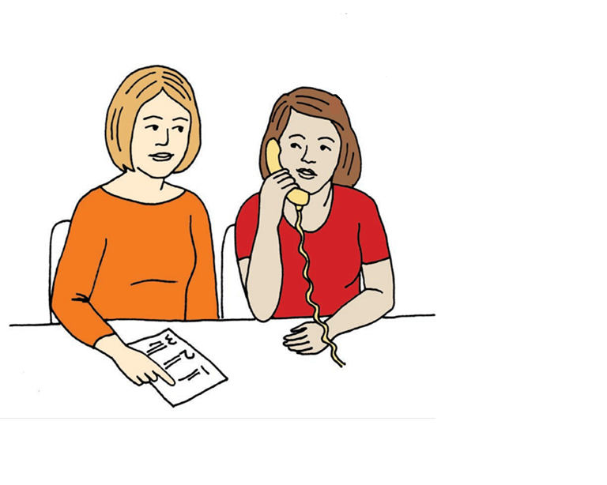
Planning with Your Support Person
Planning with your support person:
A support person is someone you feel safe with and who you can trust.
Not everyone will want or need a support person, but if you choose to have one, they can assist by helping you:
    Make your appointment.
    Fill out the “Doctor’s Visit Planning Tool” (if needed).
    Prepare for your doctor visit by role-playing or helping you make a list of things you would like to talk to your doctor about.

Slide 6
Asking if You will Have a Copay
Some insurances have copays, and some do not.
Make sure and check with your insurance and see if you need to pay a copay at the doctor’s office.
If you do have a copay, find out how much it is and bring the money with you to the doctor’s office.
Do I have to pay a copay?
How much will it cost?

Slide 7
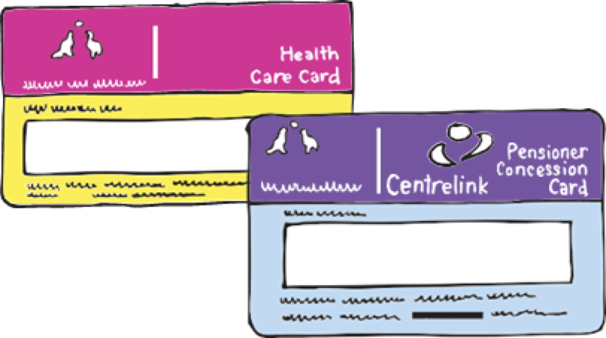
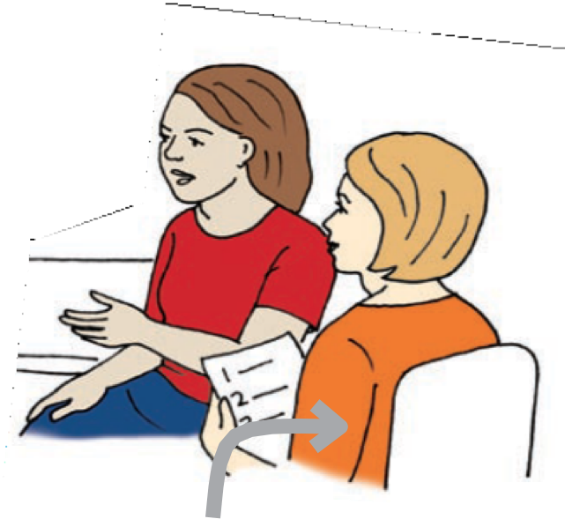

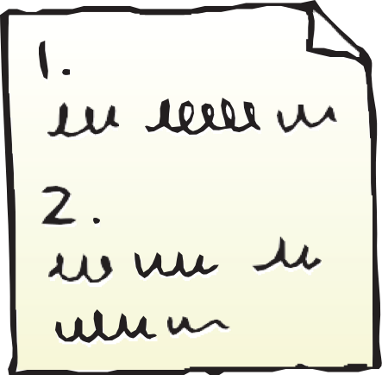
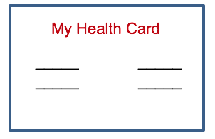
What Should I Bring to My Appointment?
  Medicare/Medicaid insurance card
  A support person if you want one
  Photo identification
  Your doctor visit planning tool
  My health card

Slide 8
DURING: Getting the Most Out of My Appointment

Slide 9
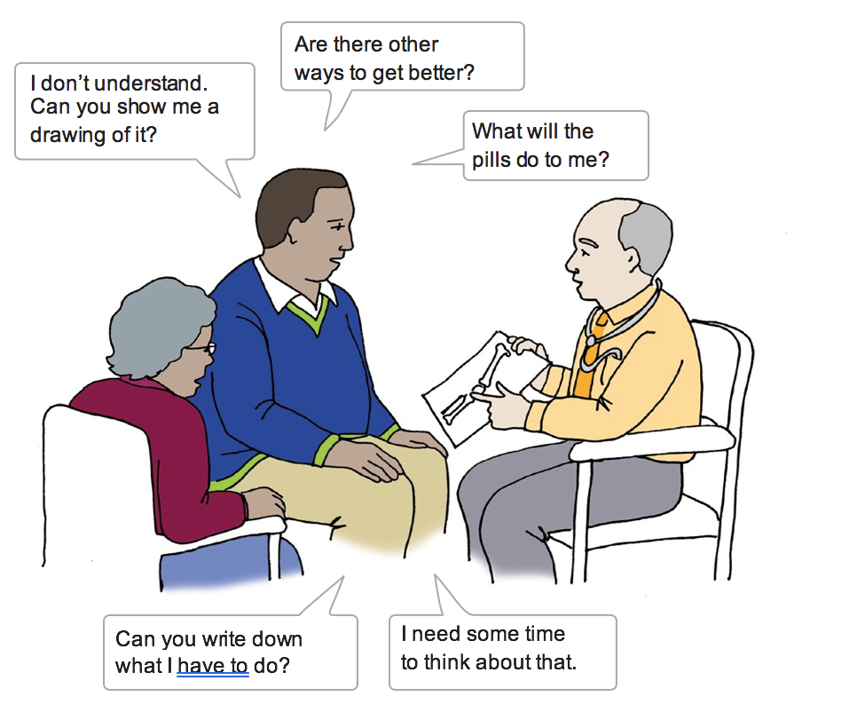
Speaking Up with Your Doctor
Remember you are in charge of your body.
You talk to your doctor about your concerns or any changes in your health.
Review with your doctor what you discussed before you leave.

Slide 10
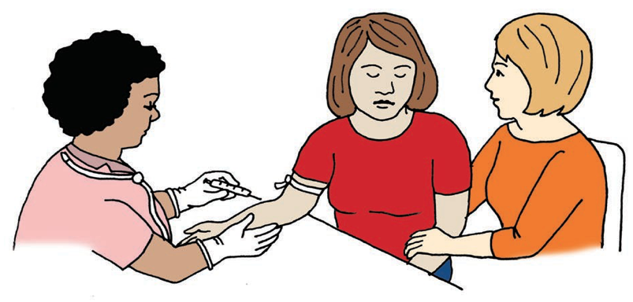
Your Support Person (Their Role)
A support person is someone you feel safe with and who you can trust. You can bring them with you to your appointments if you choose to.
Your support person’s role: To assist you or help you feel more at ease about going to visit your doctor(s).
They can help you:
  Fill out the Doctor’s Visit Planning Tool before your appointment, if you need them to.
  Prepare for your doctor visit by role-playing or helping to make a list of things you would like to talk to your doctor about.
  Take notes during the doctor visit.
  Communicate with your health care provider(s).

Slide 11
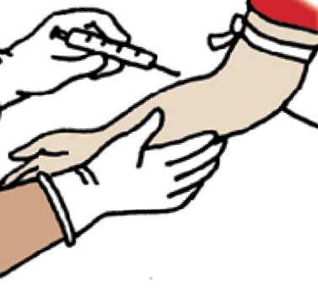
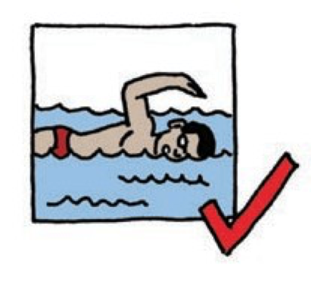


Making Choices with the Doctor
You have a say in your health. You can make your own choices at the doctor’s office.
Some of these choices could be about:
  Tests — for example, a blood test
  A plan for a healthy lifestyle — for example, being more active and eating healthier
  Medicines and treatments — for example, pills for pain and creams for rashes
  Referrals — for example, your main doctor suggests a counselor to help with your mental health

Slide 12
AFTER: Following My Doctor’s Recommendations

Slide 13
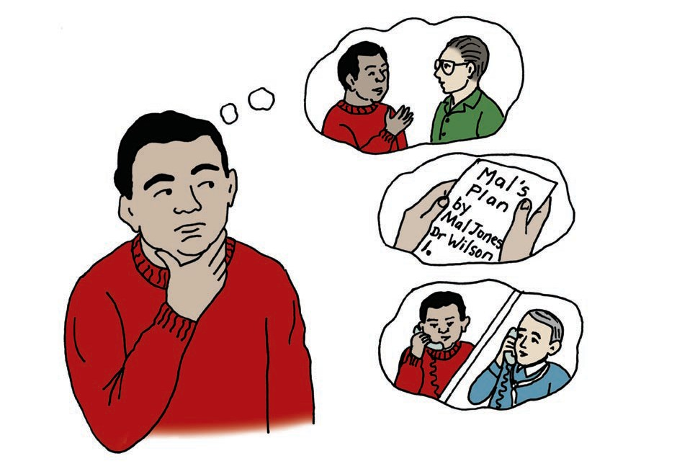
What did My Doctor Say?
Mal has been to the doctor.
He tries to remember what they talked about.
He thinks about what will help him.
Check with my support person, if I brought someone
Read what my doctor wrote.
If I’m still not sure, I can call the doctor.

Slide 14
Things to do After the Appointment
Make sure medications and/or medical supplies have been ordered. Find out when your items will be ready for pick up, and where you can get them.
Review your appointment. Look over the topics you and your doctor discussed. You may want to do this with your support person. Call the doctor’s office if you have follow up questions.
Pick up your medications and/or medical supplies. Make sure you go over the directions for your medications with your pharmacist.
Remember to follow your plan for a healthy lifestyle. Try to stick to your plan. You might need support to do this. You can ask your support person to go over it with you as well.
Don’t forget your follow up appointments. Refer to your appointment reminder card, your calendar, or ask your support person to remind you.

Slide 15
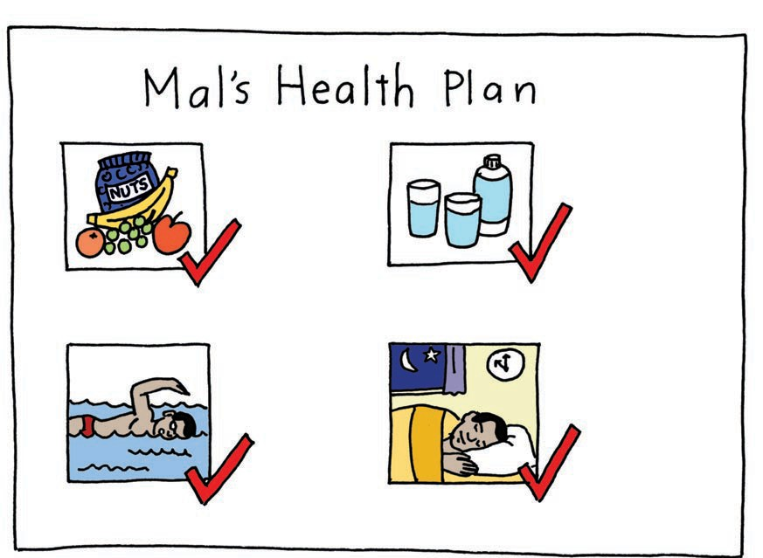
Did We Make a Plan for a Healthy Lifestyle?
Plan for a Healthy Lifestyle
Eat healthy
snacks
Drink plenty of water each day
Be active each day
Go to bed early
most nights

Slide 16
What Did I Learn?
I can take charge my health care when I:
  Know how to make appointments.
  Can bring a support person with me if I choose to.
  Know what to take when I go to the doctor.
  Get help to speak up if I need it.
  Tell the doctor ways to help me understand.
  Have a say and make choices.
  Choose to follow my plan for a healthy lifestyle.

Slide 17


Created in partnership with:
Oregon Self Advocacy Coalition,
Oregon Health and Science University, and
Oregon Council on Developmental Disabilities
This PowerPoint is adapted from materials developed by NSW Council for Intellectual Disabilities (2009), Australia.
The toolkit and its components are supported in part by Grant/Cooperative Agreement #5 U27 DD000014 from the Centers for Disease Control and Prevention, Disability and Health Branch. The contents of the toolkit are solely the responsibility of the authors and do not necessarily represent the official reviews of the CDC.

