Slide 1
Signs of Sickness
Module 6

Slide 2
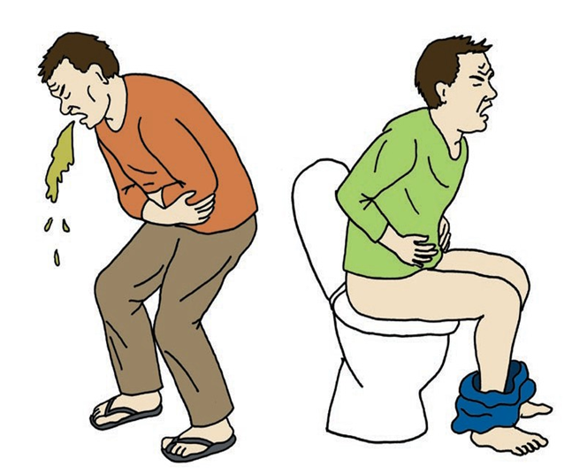
What Are Symptoms?
Symptoms are signs that we are well. They are also signs that we are sick. Another name for signs of sickness is “symptoms.”
Here are some symptoms that are easy to see:
Bleeding
Throwing up
Changes in pooping and peeing
Some symptoms are harder to see, but can be felt:
A toothache
Stomach pains
Feelings, such as being really sad or confused
Bad dreams

Slide 3



Understanding Levels of Urgency
How do you know the urgency of signs and symptoms and whether or not they are an emergency?
A simple guide on what to do is to take one of three steps for a non-emergency, for an urgent issue, and for an emergency.
For a non-emergency see your doctor this week.
For an urgent issue see your doctor today.
For an emergency, you will need an ambulance. This means they need an ambulance now! To get an ambulance, call 9-1-1!

Slide 4

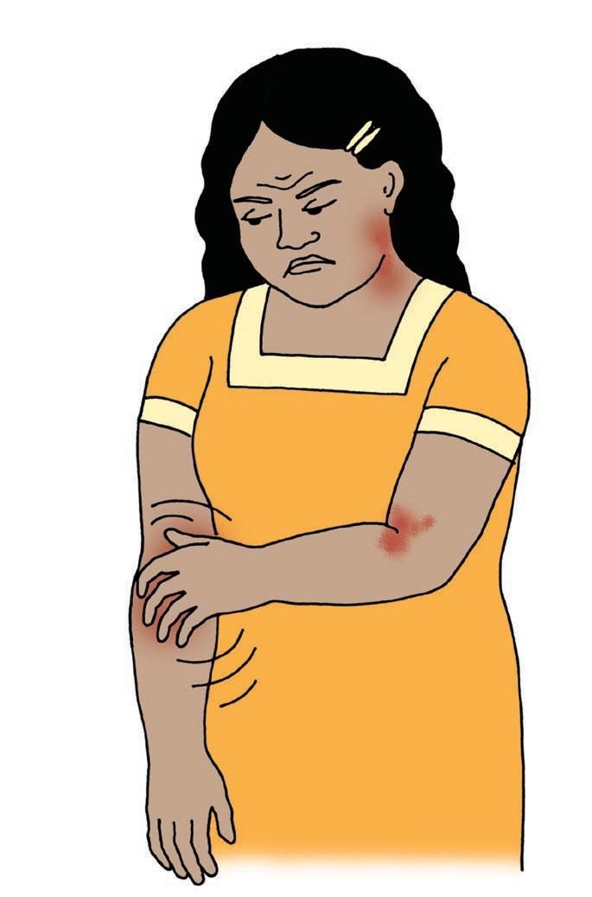

What if you…
Have a red, itchy rash?
Should you…
See your doctor this week!
See your doctor this week?
See your doctor today?
Call 9-1-1 or another emergency service?

Slide 5
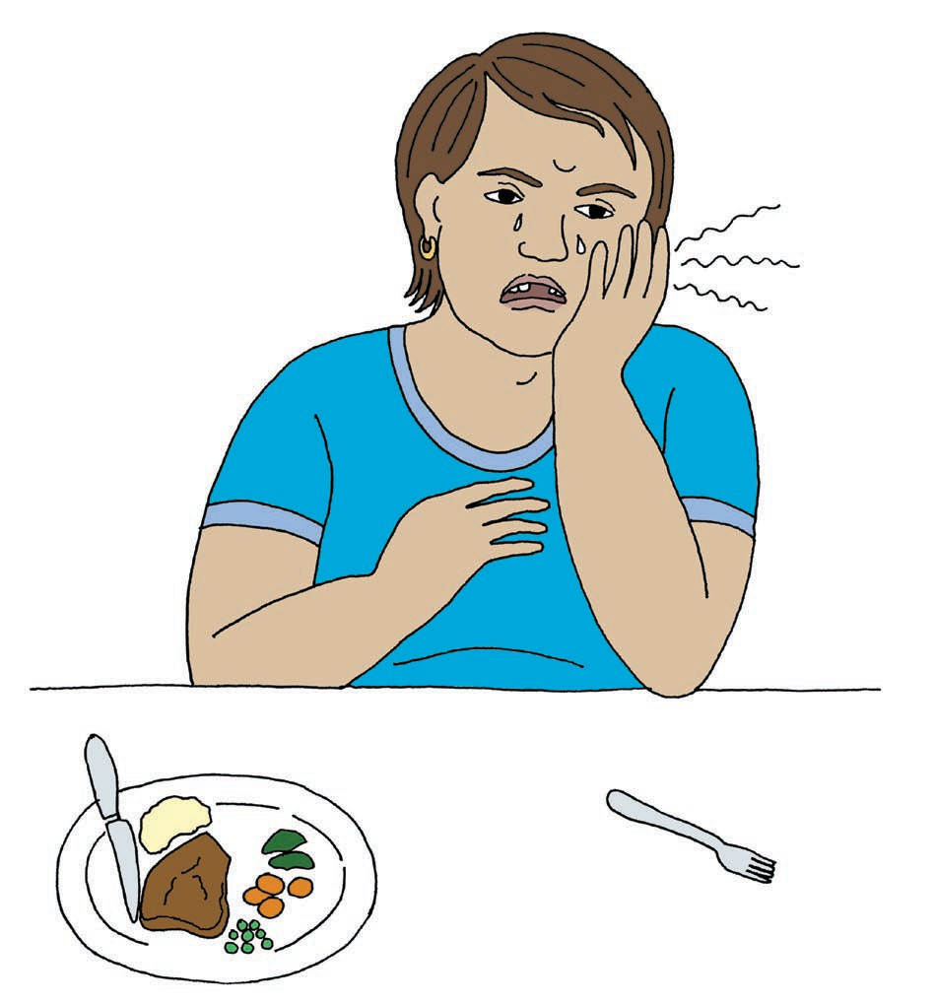
What if you…
Have a toothache?
Should you…
See your dentist this today!
See your dentist today?
See your dentist this week?
Call 9-1-1 or another emergency service?

Slide 6
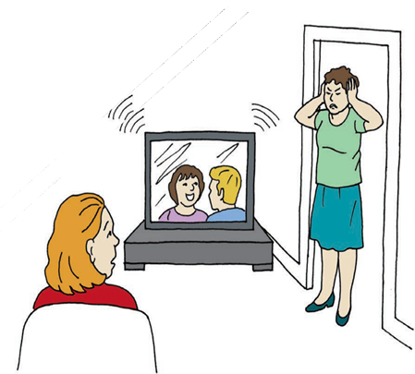
What if you…
Are having problems hearing?
Should you…
See your doctor this week!
Turn that down! It’s Too lo
See your doctor this week?
Turn that down! It’s too loud!
But I can’t hear it!
See your doctor today?
Call 9-1-1 or another emergency service?

Slide 7

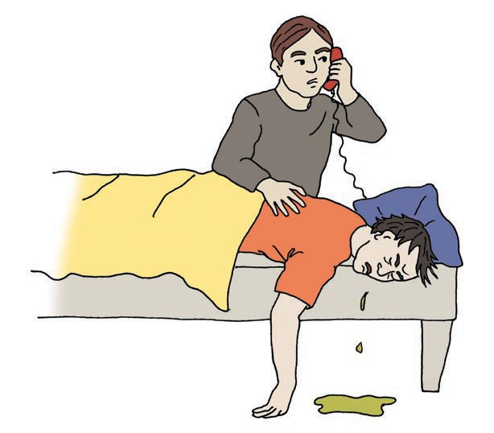
What if you…
Are having a bad reaction to your new medication?
Should you…
Call 9-1-1 or another emergency service!
See your doctor this week?
My friend took some new pills and is now really sick!
See your doctor today?
Call 9-1-1 or another emergency service?

Slide 8
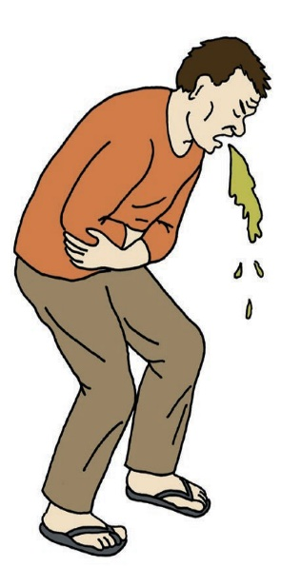
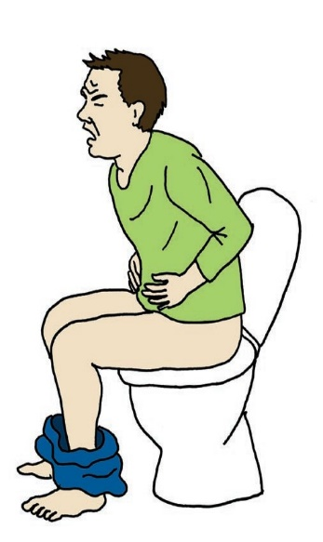
What if you…
Are having stomach pain and vomiting?
Should you…
See your doctor today!
See your doctor this week?
See your doctor today?
Call 9-1-1 or another emergency service?

Slide 9
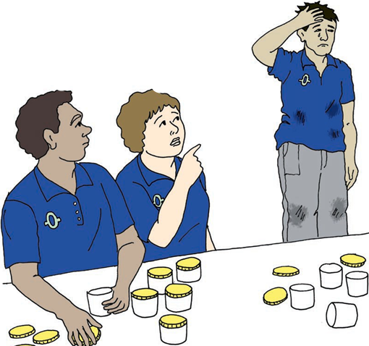
What if you…
Are feeling overwhelmed a lot lately?
Should you…
See your doctor this week!
I feel so overwhelmed. I can’t focus.
See your doctor this week?
He’s not doing his work the way he usually does.
See your doctor today?
Call 9-1-1 or another emergency service?

Slide 10
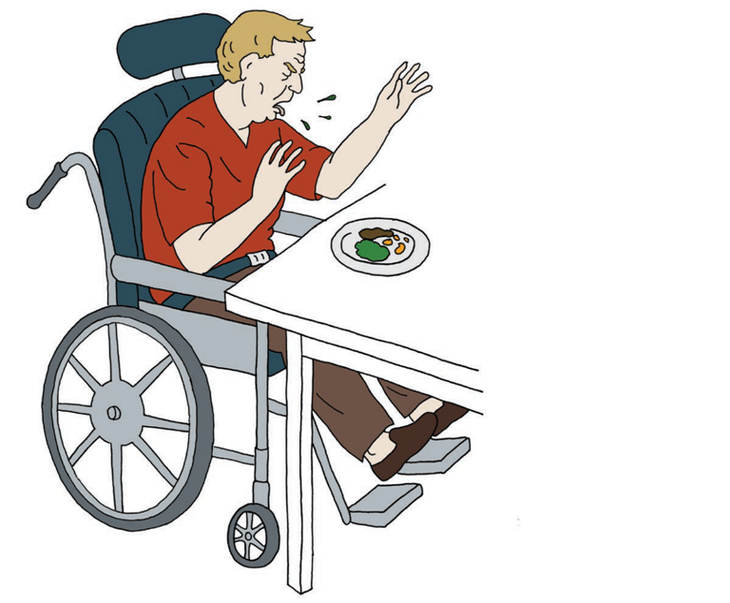
What if you…
Are having trouble swallowing?
Should you…
See your doctor today!
See your doctor this week?
See your doctor today?
Call 9-1-1 or another emergency service?

Slide 11
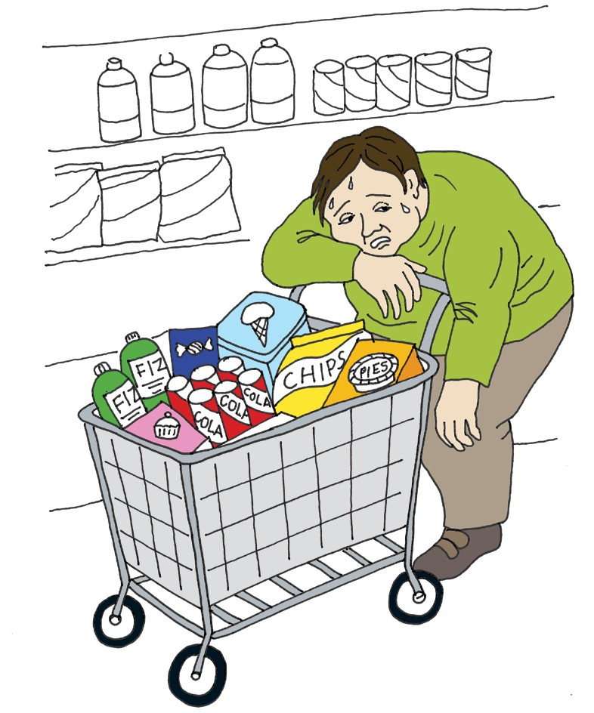

What if you…
Are feeling very tired and thirsty, peeing more than usual, and feeling numbness and tingling in your hands and feet?
Should you…
See your doctor this week?
See your doctor today?
Call 9-1-1 or another emergency service?
Call 9-1-1 or another emergency service!

Slide 12
What Did I Learn?
I can take charge of my health care when I:
Know how to recognize signs and symptoms of sickness.
Know how to identify the urgency of signs or symptoms of sickness.
Know what to do in case of an emergency.

Slide 13


Created in partnership with:
  Oregon Self Advocacy Coalition,
  Oregon Health and Science University, and
  Oregon Council on Developmental Disabilities
This PowerPoint is adapted from materials developed by NSW Council for Intellectual Disabilities (2009), Australia.
The toolkit and its components are supported in part by Grant/Cooperative Agreement #5 U27 DD000014 from the Centers for Disease Control and Prevention, Disability and Health Branch. The contents of the toolkit are solely the responsibility of the authors and do not necessarily represent the official reviews of the CDC.

