Slide 1
When My Doctor Recommends Surgery
Module 7

Slide 2

BEFORE:
Deciding to Have Surgery and How to Plan and Prepare

Slide 3
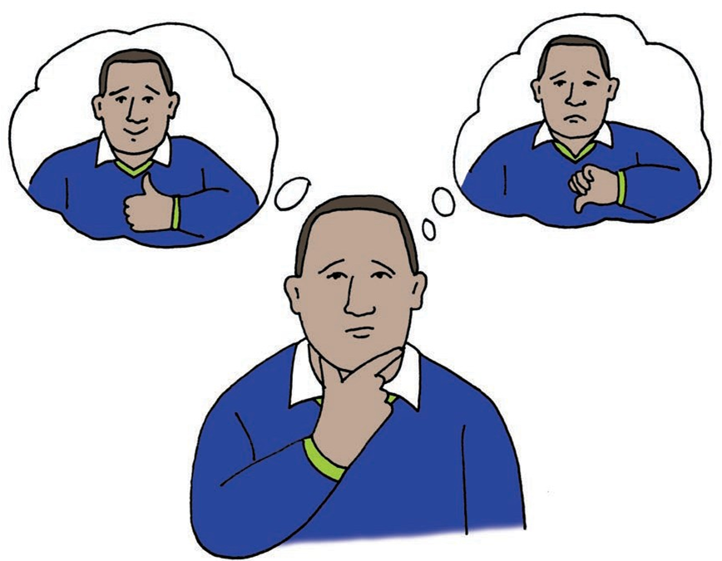
Saying Yes or No to Surgery
Ask your doctor as many questions you need to figure out as much as you can about the surgery:
What are the reasons for surgery?
Will the surgery help your quality of life?
Do you understand the processes before, during, and after surgery?
Would you like to get a second opinion?
Once you feel confident about your decision, you can let your doctor know.
Remember:
YOUR BODY, YOUR DECISION
The doctor needs your consent to do anything to your body!
George considers surgery.

Slide 4
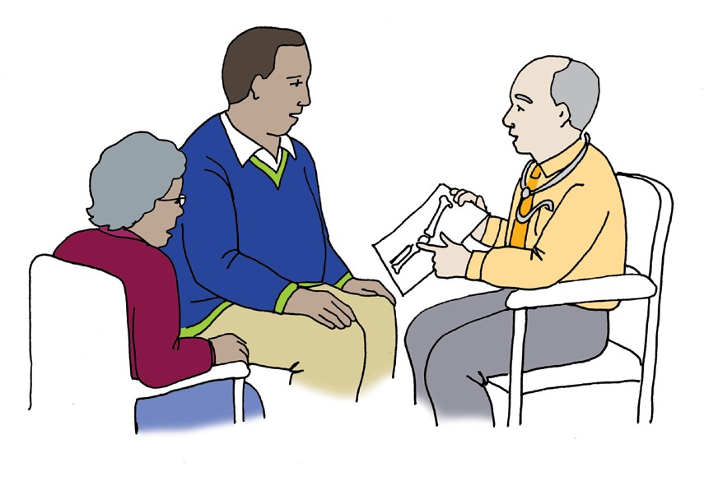
Getting Good Information about the Surgery
George wants to make the best choice for his own health.
He asks a lot of questions so he can get as much information about the surgery as he can.
When George doesn’t understand, he asks again.
He brought his Aunty along with him for support and she asks some questions too.
What are you going
to do to my knee?
What if I don’t
have surgery?
How long before
I can walk again?
Could anything
go wrong?
George will need
a lot of help after the surgery.
How long will I be asleep for the surgery?

Slide 5

Planning for Surgery
The hospital will contact you with the date and time of surgery.
Call them back to say OK to the date and time.
Tell work that you need some time off for the surgery and recovery.
Go to the Pre-op check-up. It will usually be about 1 week before the surgery.
Work out who else you should tell about the surgery.
Work out how to get to and from the hospital before and after surgery.
Once you have made the decision to have surgery, your doctor will let you know what you need to do to plan and prepare.
This may be a lot to remember so you can have your doctor or support person write down a list for you.

Slide 6
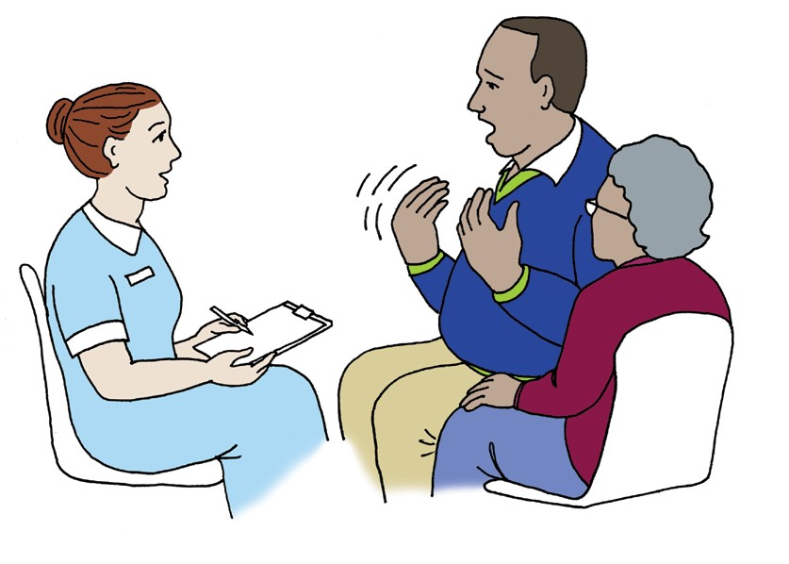
Getting Ready for Surgery
What do you need to know when you are getting ready for surgery?
    Are any tests required? Such as blood tests, urine (pee) sample, or an x-ray.
When to stop eating and drinking.
What to bring to the hospital.
What to do about your medications.
What time you should get to the hospital.
How long the surgery will take.
Where you will be taken after the surgery to recover.
Do I have to do any tests?
How long will the surgery take?

Slide 7
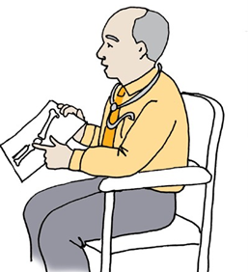
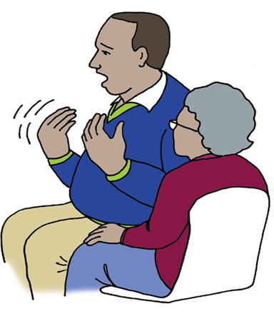

Speaking Up Before the Surgery
I have diabetes and need to be monitored.
If you are worried about the surgery or your hospital stay, talk to the doctors and staff at the hospital. They can help you plan for your stay.
I live by myself. Who can help me when I go home?
Do you have any other concerns?

Slide 8
Nervous About Your Surgery?
What comfort items may you want to bring with you to the hospital?
Headphones and music
A favorite book
Water bottle
A picture of your friends or family
A special item you have from home
You are not the only person that gets nervous, anxious, or concerned about surgery, many people do – It is OK!

Slide 9
DURING:
Going to The Hospital and Having Surgery

Slide 10
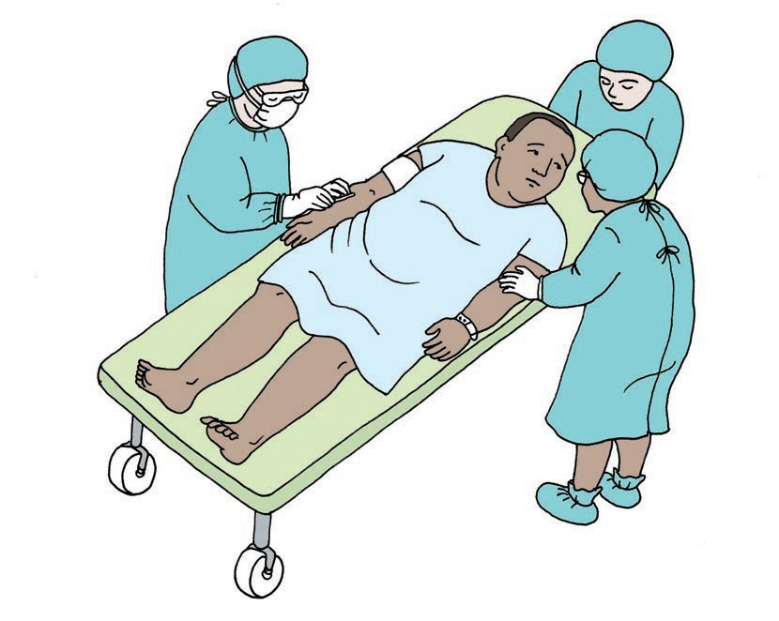
The Day of Surgery
The day of surgery may look something like this:
Check-in at the front desk.
A nurse will call you back to a room to get changed and ready for surgery.
The doctor will meet with you to discuss the surgery and recovery.
    Be sure to ask any questions you have during this time!
    The nurses and surgical staff will do final preparation with you for your surgery.
    You will be given medicine to fall asleep.

Slide 11
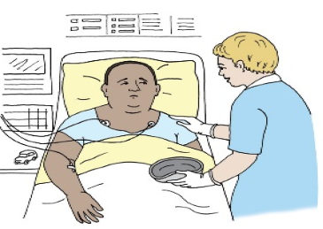
Waking Up From Surgery
Once surgery is over, you will be moved to a recovery room where you will be monitored.
When you wake up, you may:
Notice that you are hooked up to medical equipment
Feel tired
Feel nauseous
Some examples of medical equipment that may be used are:
A small tube that may go in your nose
A small tube that may go in your urethra (where your pee comes out)
Sticky pads on your chest to monitor your heart
These will be removed when you don’t need them anymore.

Slide 12
AFTER:
Planning To Go Home and After Care

Slide 13
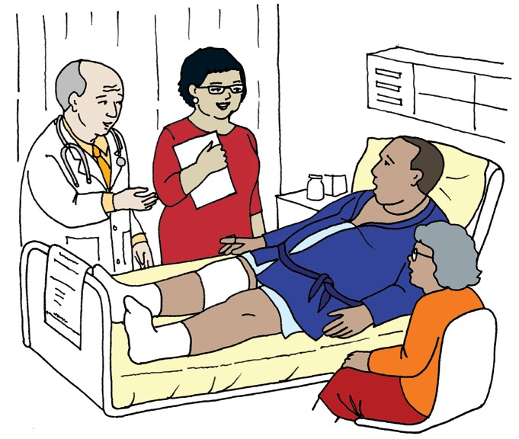
Going Home
When your doctor is ready to release you to go home, they will go over the a discharge plan with you.
What is in you discharge plan?
What you need to do to get better.
Who to call if something goes wrong at home.
Signs or symptoms to be concerned about.
Any information about new medications.
When you need to visit a specialist.

Slide 14
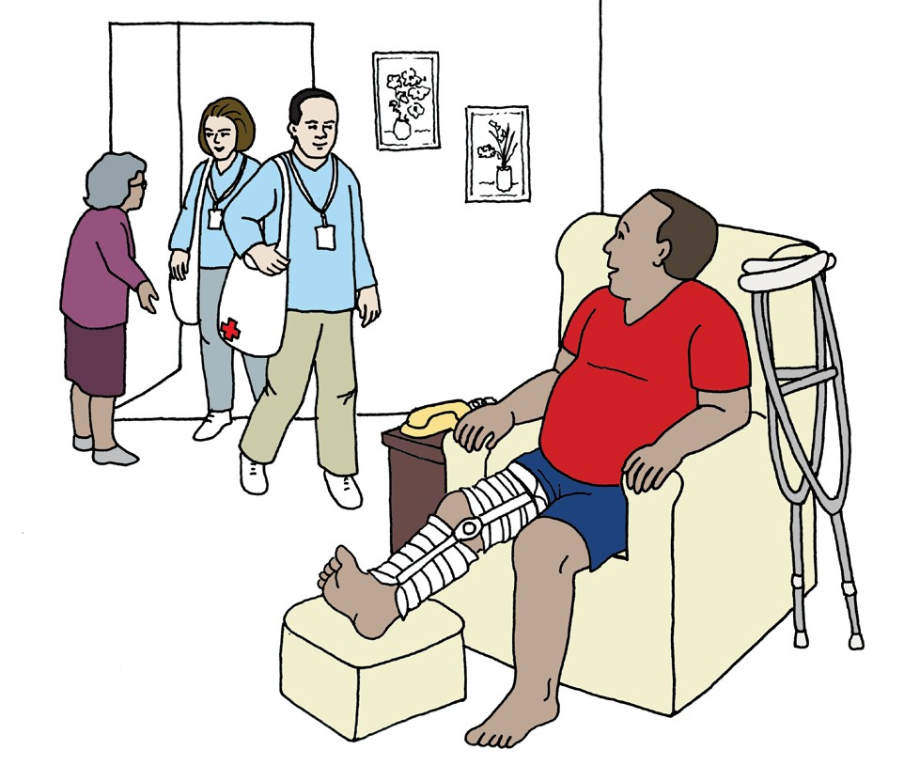
Getting Better at Home
What do you need to do once you get home?
Go over your discharge plan again and do your best to follow it.
Make sure you let your doctor know if you are having any side effects to medications and/or if you are experiencing a lot of pain.
Have a support person around to help you with your daily activities.
Relax as much as possible so you can get better.
Make and keep any doctor appointments.

Slide 15
What Did I Learn?
I can take charge of my health care when I:
Make a choice whether I should or should not have surgery.
Know how to plan for my surgery.
Understand what will happen to me the day of surgery.
Follow my discharge plan so I can get better.
Know how to take care of myself at home.
Can ask any questions I have.

Slide 16


Created in partnership with:
  Oregon Self Advocacy Coalition,
  Oregon Health and Science University, and
  Oregon Council on Developmental Disabilities
This PowerPoint is adapted from materials developed by NSW Council for Intellectual Disabilities (2009), Australia.
The toolkit and its components are supported in part by Grant/Cooperative Agreement #5 U27 DD000014 from the Centers for Disease Control and Prevention, Disability and Health Branch. The contents of the toolkit are solely the responsibility of the authors and do not necessarily represent the official reviews of the CDC.

