Slide 1
Staying Healthy
Module 9 fssdkjflsdjflksdjfion 5

Slide 2

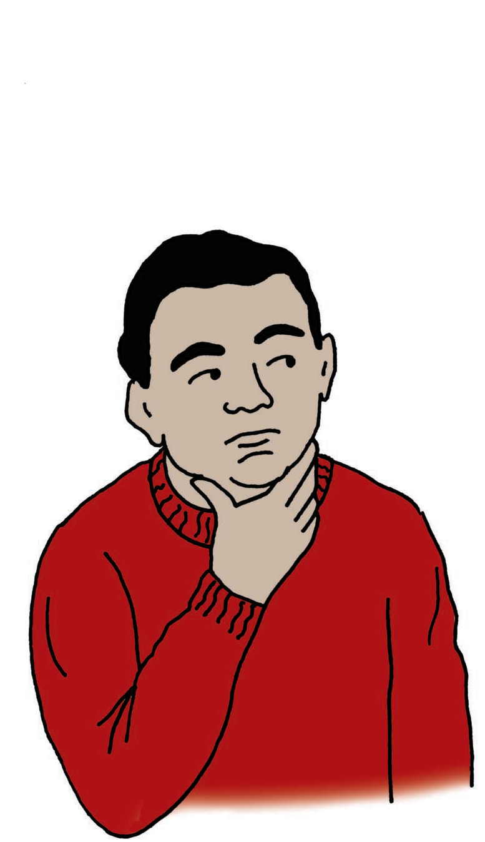
Staying Healthy Between Doctor Visits
It is important to make healthy choices between doctor visits to help maintain your health, and help you not get Type 2 diabetes or other chronic health conditions.
What are some ways you can stay healthy?
Eating healthy meals and snacks
Eating less unhealthy foods
Drinking around 8 cups of water a day
Being physically active for 30-60 minutes per day
Getting at least 7 hours of sleep per day
Taking time to do activities that you enjoy
Practicing good hygiene and safe behaviors

Slide 3








Healthy Eating
What kinds of food are considered healthy?
Vegetables: broccoli, spinach, carrots
Fruits: apples, berries, bananas, oranges
Whole Grains: quinoa, brown rice, whole wheat bread
Low-fat Dairy: milk, yogurt, cheese
Protein: lean meat and poultry, fish, nuts, beans
Healthy Oils and Fats: avocados, olive oil, nuts
WATER!! between 8 -13 cups per day

Slide 4





Foods to Limit
What kinds of food should you limit?
Sweets: candy, cookies, cakes
Fatty Foods: french-fries, fried food, pizza
Salty Foods: chips, frozen meals, canned foods
Soda and Sugary Drinks: Gatorade, energy drinks, soda

Slide 5

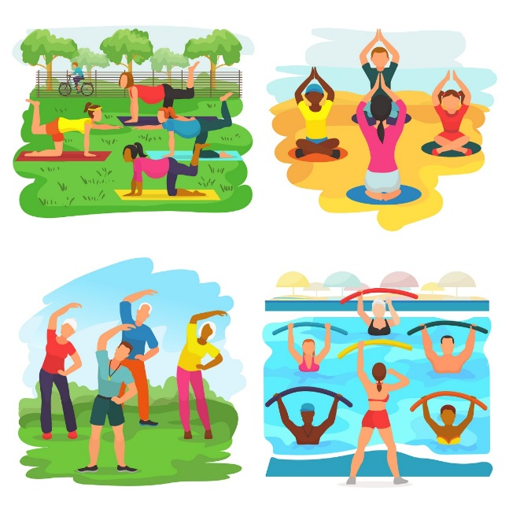
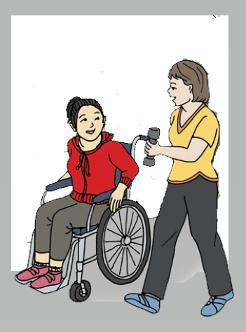

Physical Activity
Being physically active for 30-60 minutes a day leads to:
Strong bones and muscles
Healthy heart, brain, and lungs
What are some physical activities you can do that fit your lifestyle?
Lifting weights
Walking/jogging with friends
Swimming
Riding a bicycle
Gardening
Others?

Slide 6


The Importance of Sleep
Getting a good night’s sleep is good for your mental, emotional, and physical health!
What are some ideas to help you get a good night’s sleep?
  Go to bed at the same time and get up at the same time every day.
  Get at least 7 hours of sleep
  Turn off all electronics at least 30 minutes before bed time
  Be physically active during the day
  Avoid caffeine, large meals, and alcohol before bed
  Make sure your room is dark
  Have your room at a comfortable temperature

Slide 7


Emotional and Social Health
What are some ways you can support your emotional and social health?
Maintain healthy relationships with family and friends
Be involved in your community or volunteer
Maintain a positive attitude
Make time for activities you enjoy
Learn how to manage stress
Participate in a regular job, volunteer job, or hobby
Express gratitude
Be physically active
Get plenty of sleep
Set health and wellness goals and reward yourself when you achieve them
Eat healthy foods

Slide 8


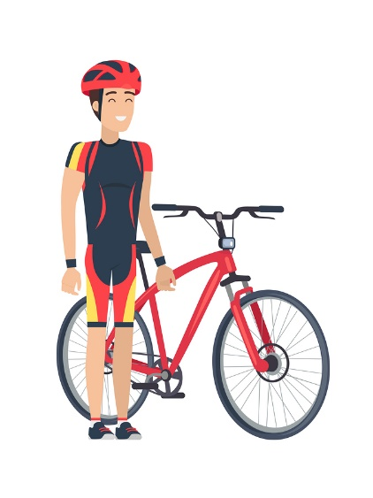

Other Tips to Maintaining Health
How else can you stay healthy?
Wash your hands after using the restroom and before eating
Brush your teeth 2 times per day
  Floss daily
  Wear visible clothing when out at night
    Light colors and reflective gear
    Wear your seatbelt when in the car and a helmet when riding your bicycle
    Avoid tobacco use. If you do use, quit!
    Ask for help if you are struggling with drugs or abusing alcohol
    Talk to your doctor about preventing sexually transmitted infections and unwanted pregnancy.

Slide 9
What did I Learn?
To help me stay healthy I:
Eat well to help my body and mind.
Stay physically active to help all parts of my body.
Get plenty of sleep to help with my mental, emotional, and physical health.
Find time for myself and others, which is an important part of my emotional health.
Know good health will help me in all areas of my life, including my health care.

Slide 10


Created in partnership with:
  Oregon Self Advocacy Coalition,
  Oregon Health and Science University, and
  Oregon Council on Developmental Disabilities
This PowerPoint is adapted from materials developed by NSW Council for Intellectual Disabilities (2009), Australia.
The toolkit and its components are supported in part by Grant/Cooperative Agreement #5 U27 DD000014 from the Centers for Disease Control and Prevention, Disability and Health Branch. The contents of the toolkit are solely the responsibility of the authors and do not necessarily represent the official reviews of the CDC.

