Slide 1
CVs and Cover Letters
aka those things you’ve heard of and sorta feel like you should have started working on but you don’t have the time, the interest or the knowledge of what either really is

Slide 2
Part 1: What am CV?

Slide 3
CV vs Resume
Resumes
  Used more in the business world
  Brief review of work experience and skills
  Typically a page or less
  Highly tailored to the job
CV
  Used more in academics
  More descriptive of education and experience
  Typically two pages
  More generalized

Slide 4
Types of Curricula Vitae
Academic CV
  Geared towards folks who want to be clinician educators or apply for grants
  Use the OHSU format
  Also requires an Educator’s Portfolio
Non-academic CV
  Geared towards folks who are applying to non-academic jobs (most of you)
  Use the provided sample format
  No Educator’s Portfolio required
    However, if you are thinking of going back to academics you should keep one

Slide 5
Educator’s Portfolio
“[an] Organized means of presenting the breadth, volume and effectiveness of your teaching contributions” – Alan Hunter
“That thing I keep forgetting to update” - everyone
Beyond the scope of today’s talk

Slide 6
What is the number one mistake people make with their CV?
Besides being weirded out that the pleural of CV is…CV

Slide 7
They don’t follow the format

Slide 8
CV
Should be:
  Organized
  Easy to follow
  Highlight important aspects of your career
  Not ugly

Slide 9
Why does all this matter?
The people reviewing your CV are reading lots and lots of them so small errors stand out
It is the most basic test of your competence
  If you cannot even do this correctly it doesn’t say great things about your ability to do the actual job
  Is that fair?
  No.
  But that’s how it is.

Slide 10

Joe every time he reads a bad CV

Slide 11
Don’t do that to Joe

Slide 12
Part 2: How to Format Your CV

Slide 13
OHSU CV Template
Contact information
Current Academic Position (if you have one)
Education (includes residency training)
Professional Experience (if you have worked after graduating)
Scholarship
  Research
  Publications
  Lectures/Conference presentations/Professorships
Service
  Professional society membership
  Committees
  Community Service
Teaching
  Honors & Awards

Slide 14
Non-Academic Template
Contact information
Education (includes residency training)
Scholarship
  Research
  Publications (posters, abstracts, book chapters, etc)
Teaching
  Honors & Awards

Slide 15
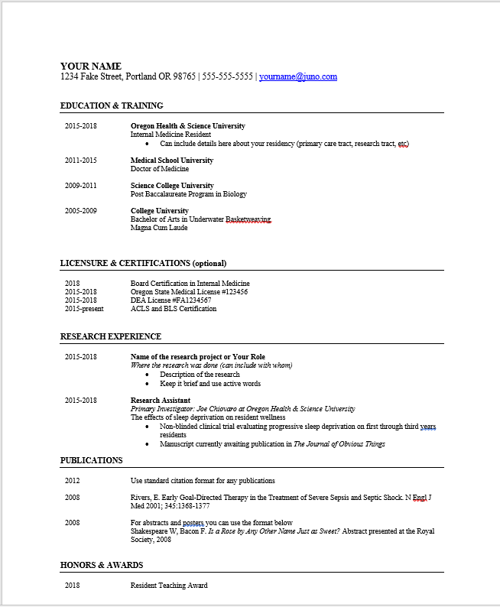
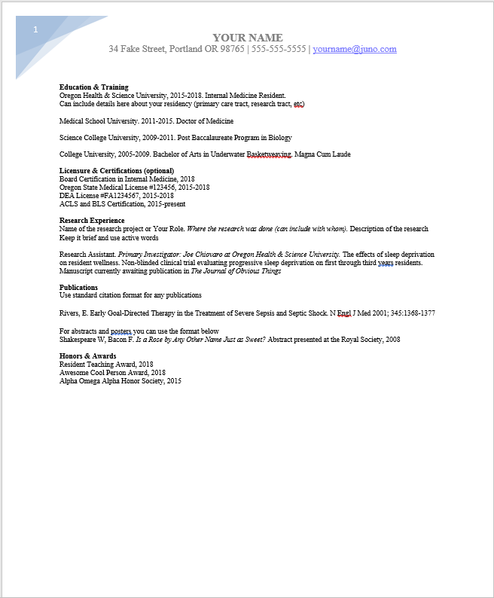

Slide 16
Part 3: Cover Letters

Slide 17
Cover Letter
Your chance to:
  Explain any gaps in your CV
  Add context to things you’ve done
  Sell yourself
Not a place to be:
  Overly humble
  Overly arrogant
  Funny
Unless you’re an amazing writer, keep it:
  Structured
  Straightforward

Slide 18
Cover Letter Tips
Identification
  Your name and contact information
  The name, title, organization of the person you’re right to
Should be no more than three (or four) paragraphs
  Paragraph 1: Intro
  Paragraph 2: Sell yourself. Why you over other applicants?
  Paragraph 3: Quick conclusion
Closing
  “Sincerely,” “Best regards,” or “Yours truly” are all fine

Slide 19
Time to practice!

