Slide 1


Completing the Master’s Thesis in Biomedical Informatics
April 7, 2020 PRESENTED BY: Diane Doctor, MLIS, Educational Programs Coordinator
Dept. of Medical Informatics & Clinical Epidemiology

Slide 2
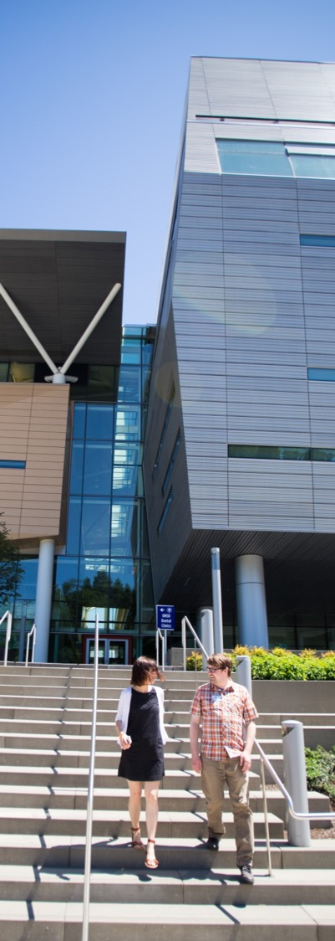
Pre-thesis preparation
Must complete 18 credits before beginning the 4-term process
Choose a thesis mentor
Submit Mentor/Advisor Assignment Form
Review DMICE Thesis Requirements on website (see “Student Resources” page)
Review past theses on OHSU Library website
Submit 1-2 page outline of project (include study design, plan for the work, anticipated results, etc.)

Slide 3
Forming your TAC
Review Thesis Advisory Committee (TAC) Guidelines on the Student Forms tab: https://www.ohsu.edu/school-of-medicine/graduate-studies/forms-and-policies
Form your TAC
  If you’re not sure who should be on your TAC, speak to your advisor
  Review Faculty Research Interests document
  Minimum of 3 members
3

Slide 4
Forming your TAC (cont.)
Name your TAC (cont.)
  At least 2 members must be on SOM Graduate Faculty (not the same as OHSU Faculty)
  At least 2 members (including Chair) must have TAC experience
  May have 1 outside member (non-Graduate Faculty or non-OHSU)
  Thesis Mentor may be the Chair
Submit Request for Thesis Advisory Committee form
Register for BMI 503 Thesis (2 cr. to develop specific aims)
4

Slide 5
Deciding on a final deliverable
Option 1: traditional research paper
Option 2: one manuscript in publishable format
  Students are encouraged to submit prior to graduation (though not required)
  Does not have to be accepted prior to graduation
  See “Thesis/Dissertation as Manuscript Option” document on Student Resources page of DMICE website
5

Slide 6
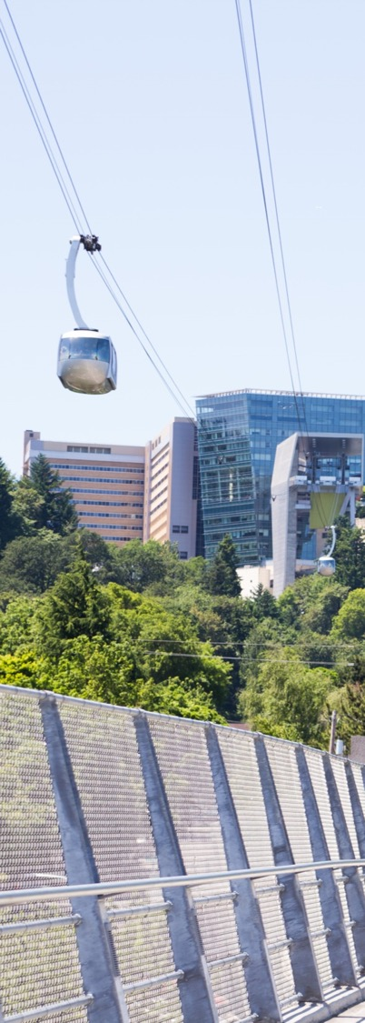
Deciding on a final deliverable (cont.)
If final deliverable is a manuscript in publishable format:
  You will have 2 versions; 1 to submit to journal, 1 to submit to OHSU as final deliverable
  Follow guidelines of the journal of choice
  Your journal may limit number of references
  Each journal has its own specifications for Appendices, Tables, Illustrations, Abbreviations, Typing
  Review Thesis/Dissertation as Manuscript Option on Student Resources page to “package” your manuscript for OHSU
    Methods, Results and Discussion chapters must be expanded for final submission to OHSU.
    Include all references used.
6

Slide 7

First term of BMI 503 Thesis-2 credits
DMICE recommends having a TAC meeting at least once every quarter; SOM requires once every 6 months
Schedule 1 1/2 hours for first TAC meeting early in the term
Prepare 4 or 5 slides, including Slide 1 Template (see next slide)
Present current state of your research
Purpose of meeting is to obtain input from Committee as you develop your proposal
Complete TAC Meeting Summary Form
Meet with advisor regularly for remainder of term
7

Slide 8
First term of BMI 503 Thesis-2 credits
First TAC Meeting Slide 1 Template
Purpose of today’s meeting:
Present 4-5 slides outlining current status of my research
Summarize literature review
Identify gaps in the research
Suggest possible research questions
Obtain feedback from Committee regarding possible research questions
Obtain feedback from Committee regarding possible specific aims (2)
Obtain additional feedback to help me develop my proposal
8

Slide 9

First term of BMI 503 Thesis-2 credits (cont.)
Begin work on your proposal
Include:
  Introduction
  Background
  Specific Aims
  See Guidelines for completion of degree Master’s with thesis, and Guidelines for preparation of dissertation and thesis https://www.ohsu.edu/school-of-medicine/graduate-studies/forms-and-policies
9

Slide 10

Second term of BMI 503 Thesis-
2 credits
Complete development and write up of proposal
  Methods
  Limitations
  Anticipated Results
  Bibliography

Slide 11
Second term of BMI 503 Thesis-
2 credits
Begin process to obtain IRB approval or exemption: https://www.ohsu.edu/research-integrity/irb-policies-and-forms. Your capstone advisor is the “PI”.
Schedule pre-defense and public defense
Hold pre-defense meeting with Committee (this serves as a TAC meeting) . Complete TAC Meeting Summary Form.
Proprietary information? If so, complete Step 1 (“Go/No Go”) Form (on Forms page of website) if you do not want to livestream or record. All of your Committee members must attend in person with this option.
Defend proposal in BICC 124
11

Slide 12
Third term of BMI 503 Thesis-
4 credits
Research, data collection, data synthesis, writing
Meet with advisor regularly
Meet with TAC at least once to present current status of research (with slides)
Complete TAC Meeting Summary Form
Log into SIS and Apply to Graduate
12

Slide 13
Fourth term of BMI 503 Thesis-
4 credits
Meet with advisor regularly
Send draft of write up to committee early in the term
Schedule pre-defense (TAC meeting) and public defense
Submit Request for Oral Examination with faculty signatures 30 days before public defense
13

Slide 14
Fourth term of BMI 503 Thesis-4 credits (cont.)
Prepare the thesis per SOM Guidelines and Requirements. Include:
  Introduction (includes Background and Specific Aims)
  Methods
  Results
  Discussion (includes Limitations)
  Summary and Conclusions
  Areas for future research
  Bibliography
  Appendices
14

Slide 15
Fourth term of BMI 503 Thesis-
4 credits (cont.)
Formatting and citation:
  See SOM Guidelines and Regulations Section 4 for formatting rules. Be consistent.
  Choose one citation style and be consistent
    Vancouver (recommended)
    APA
    MLA
  Examples of Vancouver style https://www.nlm.nih.gov/bsd/uniform_requirements.html
  Online Writing Lab (OWL) at Purdue https://owl.english.purdue.edu/owl/
15

Slide 16
Fourth term of BMI 503 Thesis-4 credits (cont.)
Form Oral Examination Committee
  At least one member must be from outside student’s program
  May be the same members as on TAC if all requirements are met
  Thesis mentor may not be Chair
16

Slide 17
Fourth term of BMI 503 Thesis-4 credits (cont.)
Send slides and write up to committee two weeks before pre-defense
Pre-defense meeting with committee
  This is a timed, rehearsed dry-run of public defense (40 minutes)
Public thesis defense
Followed by 30-minute oral examination by Committee
Submit signed Oral Examination Certification within 48 hours of defense
17

Slide 18
If you need a fifth term of thesis…
Continue to register for 1 credit of BMI 503 Thesis each term until you turn in final writeup
If you do not submit write up 6 months after defending, you will need to re-defend
18

Slide 19
Submit final documents
Certificate of Approval page signed by committee members (becomes page 2 of thesis). Electronic signatures are acceptable.
PDF of thesis to:
  ethesis@ohsu.edu (library)
  Diane
Document Submission Form to ethesis@ohsu.edu
Electronic Publication Permission Form to ethesis@ohsu.edu:
  Immediate Release, or
  Delayed Release (3 years)
19

Slide 20
Thesis Binding
Order 2 bound copies of thesis at www.thesisondemand.com
  1 for mentor
  1 for department
May order extras for yourself in a separate order
20

Slide 21
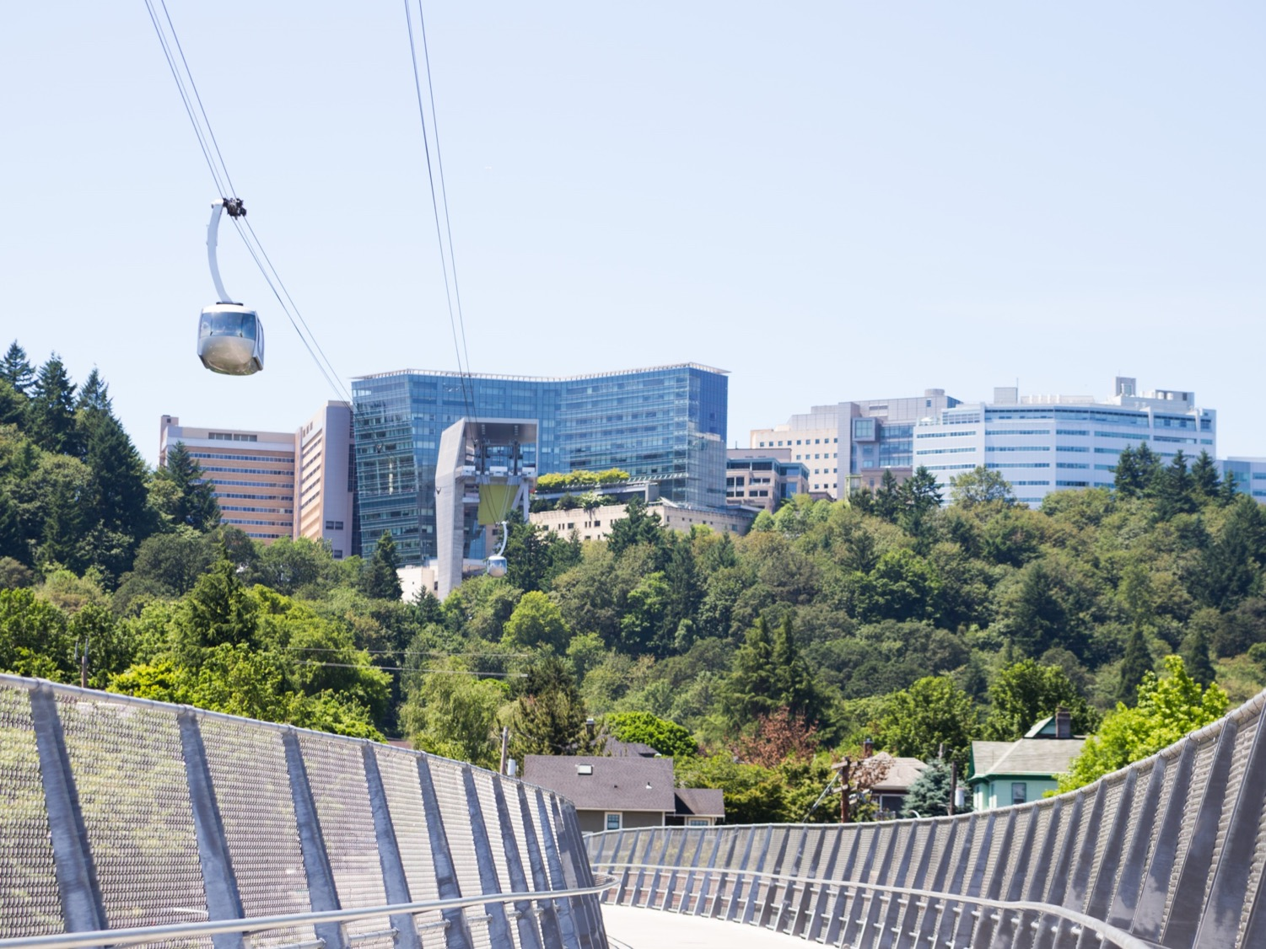
Questions?

