Slide 1
Oral Health
Module 11

Slide 2
Is oral health just taking care of your teeth?

Slide 3
The Importance of Oral Health
Oral health is taking care of your teeth and mouth, which includes your teeth, gums, tongue, and the inside of your cheeks.
Oral health is important because:
It can help prevent oral diseases like cavities and gum disease.
It helps keep your breath smelling fresh and your teeth clean.
It helps you feel confident.
It helps keep your body healthy and is important for your overall well-being.

Slide 4
Good oral health helps your entire body by:
Fighting diseases so you can stay healthy.
Playing a role in protecting your brain,
heart, and lungs.
Keeping illnesses such as arthritis
and diabetes from getting worse.
Helping a pregnant person
have a healthier pregnancy.

Slide 5
What questions do you ask when you are making your dental appointment?

Slide 6
BEFORE: Planning for Your Dental Appointment

Slide 7
Making an Appointment
Your health insurance provider can help you find a dentist that is covered under your plan, or can ask someone you trust if they know a dentist that might be a good fit for you.
Ask if you need to pay a copay or if you will be expected to pay what you owe the same day as your appointment.
When you make an appointment, the receptionist may ask you questions like:
  When was the last time you saw a dentist?
  When was the last time you had your teeth cleaned?
  Have any of your teeth been bothering you?

Slide 8
Requesting Accommodations
Some accommodations you may need to consider requesting:
Lighting adjustments
Large print materials
Interpreters
Need extra time
Wheelchair accessible
  Do you usually need to be transferred to an exam chair or do you stay in your wheelchair?
Ask the dental hygienist and dentist to explain what they are doing before they do it.

Slide 9
What do you do to prepare for your dental appointment?

Slide 10
DURING: The Day of Your Appointment

Slide 11
Preparing for Your Appointment
Before your appointment, you may want to:
Brush and floss your teeth
Wear comfortable clothes
Bring an item with you that helps you feel comfortable and relaxed
  Headphones so you can listen to music or soothing sounds

Slide 12


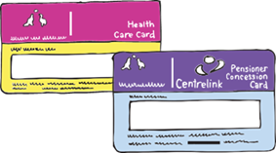
Preparing for Your Appointment
Call ahead to make sure your appointment is on time to reduce waiting time.
Remember your paperwork, photo I.D., list of medications, completed forms, and insurance information.
Arrive 15 minutes before your appointment, or sooner if the office asks.

Slide 13
At the Dentist’s Office
Every Dentist’s office is different. Some of the staff you may meet include:
The receptionist will greet you and help you get checked in.
The dental hygienist will examine your mouth,
head, and neck and clean your teeth.
The dentist will examine your teeth
to identify and treat any dental problems.
They may also have an assistant to help them.

Slide 14
AFTER: Daily Home Care

Slide 15
Steps to Brushing Your Teeth
Step 1: Put a small pea sized amount of toothpaste with fluoride on your toothbrush.
Step 2: In a circle motion, brush the tops of your back teeth.

Slide 16


Steps to Brushing Your Teeth
Step 3: Brush the outsides of all your teeth using circle motions. Brush the insides of all your teeth, using the tip of your toothbrush for the back of your front teeth. Also, make sure to brush your gums.
Step 4: Brush your tongue.

Slide 17

Steps to Brushing Your Teeth
Step 5: Spit into the sink.
Step 6: Do not rinse your mouth out with water. Leave toothpaste in your mouth to help keep your teeth strong and fight cavities.

Slide 18

Steps to Brushing Your Teeth
Step 7: Rinse your toothbrush off and put it away.
Step 8: Wipe your mouth.
Note: It is important to brush your teeth for at least 2 minutes!
Be sure to change your toothbrush every 3 months or after an illness.

Slide 19
Steps to Flossing Your Teeth
Everyone flosses their teeth in different ways. Your dentist will help you find what way works best for you.
Flossing your teeth daily is an important part of oral hygiene because it helps to get the food and germs that may be stuck in between your teeth.

Slide 20
What are Cavities?
A cavity is an infection in the tooth caused by germs in the mouth.
Germs use the sugar and starches in the food you eat to make acid, which can cause holes in your teeth.
If not treated by a dentist, these holes can grow bigger and deeper and can:
  Cause pain
  Make it difficult to eat, talk, and smile
A dentist can fill a cavity with special material.

Slide 21


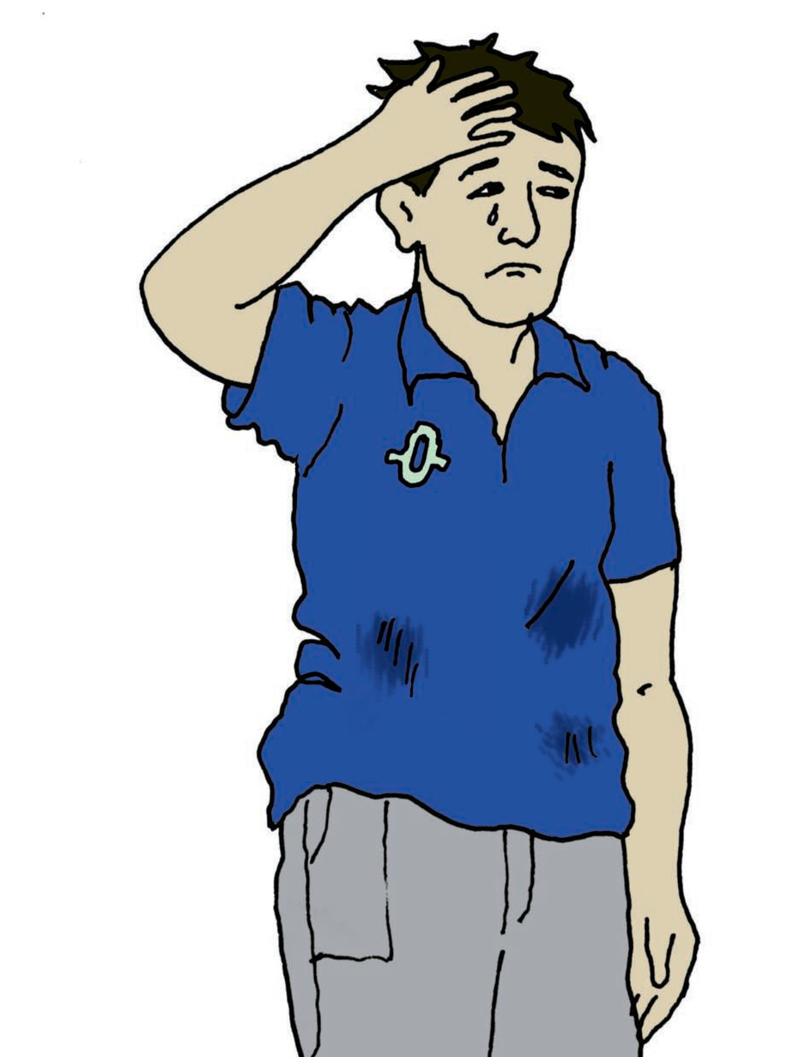
What Can Cause Cavities and Gum Disease?
Eating sugary foods between meals.
Certain medications or health conditions.
Leaving food and germs and teeth.
Poorly controlled diabetes.
Tobacco use.
Stress

Slide 22
What is Gum Disease?
Gum disease is an infection that affects the gums and bone that supports the teeth, which can lead to tooth loss.
Most of the time, there are no symptoms in early stages. Your gums might bleed when you brush, but usually there is no pain.
As the gums begin to recede, you might have sensitivity to hot and cold temperatures.
When bone around the teeth is lost,
the teeth will become loose.

Slide 23


Preventing Cavities and Gum Disease
It is important to do your best to try and prevent cavities. Here are some ways you can do that:
Use fluoride product at home if recommended by your dentist or dental hygienist.
Brush your teeth at least twice a day and floss daily.
Save sugary foods for mealtime.

Slide 24




Preventing Cavities and Gum Disease
In between meals, snack on foods that do not create acid like:
    Cheese
    Fresh fruits and vegetables
    Nuts
Have regular dental checkups and cleanings.
Always follow your dentist’s or dental hygienist’s instructions and ask questions if you do not understand.
If you have diabetes, follow your medical doctor’s advice for managing it.

Slide 25
What are some ways that we can prevent cavities and gum disease?

Slide 26
What Did I Learn?
I can take charge of my health care when I know:
Why good oral health is important
How my oral health affects my whole body
What accommodations are best for me and how to ask for them
How to care for my teeth and gums
What causes cavities and gum disease and how to prevent them

Slide 27


Created in partnership with:
  Oregon Self Advocacy Coalition,
  Oregon Health and Science University, and
  Oregon Council on Developmental Disabilities
The toolkit and its components were supported in part by the Grant or Cooperative Agreement Number DD000014, funded by the Centers for Disease Control and Prevention and by the University Center Excellence in Developmental Disabilities Administration on Community Living Grant #90DDUC0039-03-02. Its contents are solely the responsibility of the authors and do not necessarily represent the official views of the Centers for Disease Control and Prevention, Administration on Community Living, or the Department of Health and Human Services.

