Slide 1
Trauma-Informed Pedagogy
Faculty Development Friday
Holly Villamagna MD and Erin Bonura MD, MCR
5/7/21

Slide 2
Outline
Introduction (10 min)
Define trauma-informed pedagogy
Brief literature review
Consider a potential link between trauma-informed care and pedagogy
Trauma-informed pedagogy seminar: Mays Imad, PhD (20 min)
Breakout discussion #1 (15 min)
COVID-19 elective: design, emergent themes, and application to trauma-informed pedagogy (10 min)
Breakout discussion #2 (15 min)
Regroup and conclusion (10 min)

Slide 3
Introduction to Trauma-Informed Pedagogy
The COVID-19 pandemic has accelerated conversations about how educators should address learner stress and trauma
Trauma-informed pedagogy is an emerging approach to education, including medical education
Core principles of trauma-informed pedagogy:
Recognize that stress inhibits learning, and that trauma effects executive functioning and self-regulation
Adjust both the curricular content and the learning environment to help learners who are experiencing stress and trauma succeed in their education

Slide 4
Intro to Trauma-Informed Pedagogy: Literature Review
Very limited peer-reviewed publications in general education literature, but several recent articles, seminars, etc discussing pedagogical techniques for teaching at times of stress and trauma. For example:
Chronicle of Higher Education Trauma-Informed Teaching Explainer suggests:
Collaborating with colleagues for ideas and to help manage educator stress
Clear course structure and expectations, but with flexibility for students
Help students with organization/retention: many reminders about deadlines, more re-emphasizing key concepts while teaching
Give students more agency: involve them in course design, creation of assignments
Beth McMurtrie, Teaching Newsletter, The Chronicle of Higher Education

Slide 5
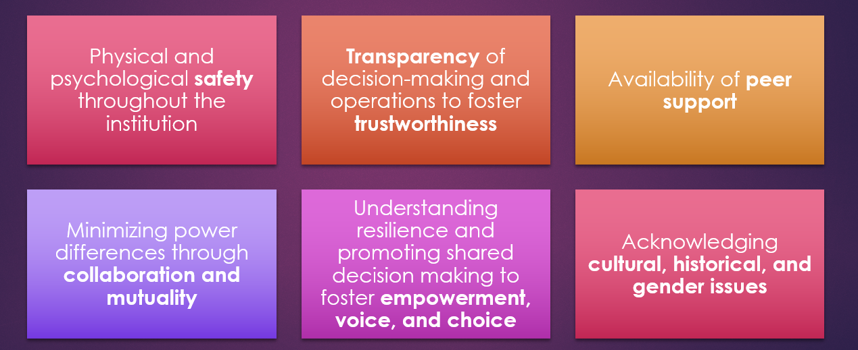
Linking Trauma-Informed Pedagogy to Trauma-Informed Care
2020 perspective piece in Academic Medicine proposed integration of the principles of trauma-informed care into undergraduate medical education to create a new paradigm of trauma-informed medical education
Trauma-informed care: recognize prevalence of trauma, create medical environment to promote healing
Brown et al. Acad Med. 2020 Jul 14

Slide 6
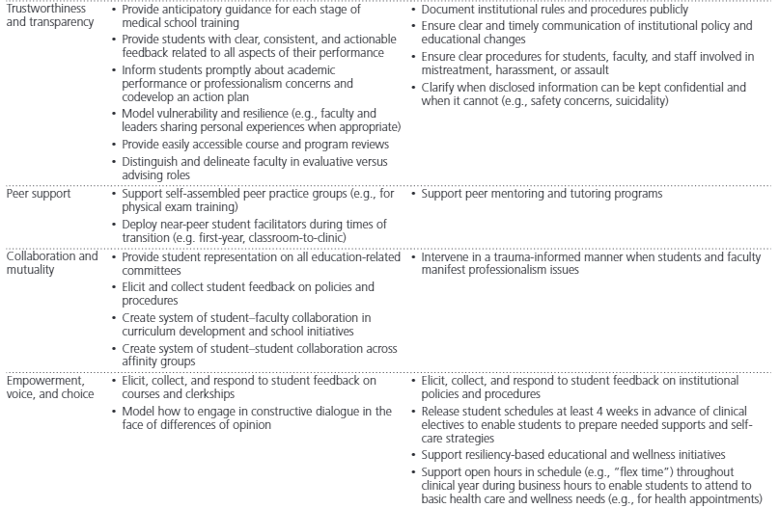
Brown et al. Acad Med. 2020 Jul 14

Slide 7
Outline
Introduction (10 min)
Define trauma-informed pedagogy
Brief literature review
Consider a potential link between trauma-informed care and pedagogy
Trauma-informed pedagogy seminar: Mays Imad, PhD (20 min)
Breakout discussion #1 (15 min)
COVID-19 elective: design, emergent themes, and application to trauma-informed pedagogy (10 min)
Breakout discussion #2 (15 min)
Regroup and conclusion (10 min)

Slide 8
Trauma-Informed Pedagogy Seminar
What does trauma-informed pedagogy look like in the classroom?
Presenter: Mays Imad, PhD, neurobiologist at Pima Community College
Goals of the talk:
Understand what trauma is and the physiological impacts of traumatic experiences
Impact of trauma on the brain and learning
Strategies to mitigate impact of trauma and improve learning
Link to seminar
Notes:
Show ~20 minutes: 31:57 – 50:37

Slide 9
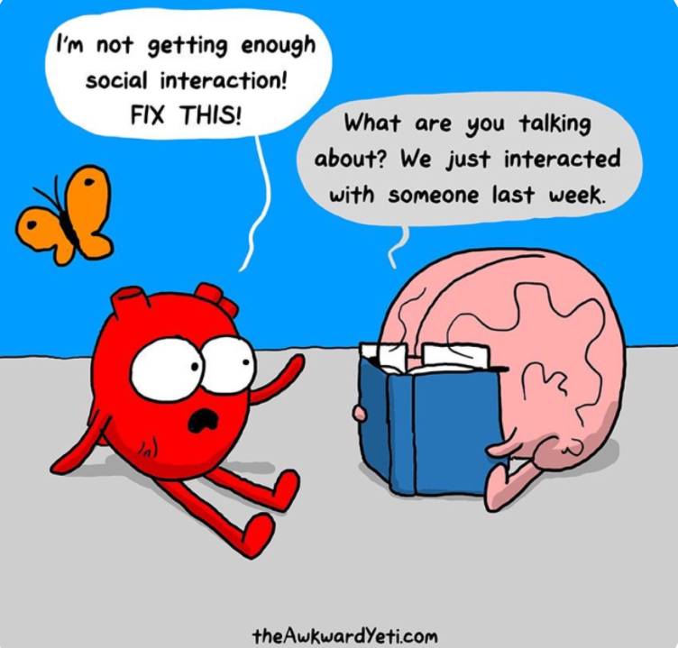
Breakout discussion #1
What is your initial impression of trauma-informed teaching/pedagogy?
How do you feel about the connection between trauma-informed care and pedagogy? Do you have any concerns about applying trauma-informed care principles to medical education?

Slide 10
Outline
Introduction (10 min)
Define trauma-informed pedagogy
Brief literature review
Consider a potential link between trauma-informed care and pedagogy
Trauma-informed pedagogy seminar: Mays Imad, PhD (20 min)
Breakout discussion #1 (15 min)
COVID-19 elective: design, emergent themes, and application to trauma-informed pedagogy (10 min)
Breakout discussion #2 (15 min)
Regroup and conclusion (10 min)

Slide 11
COVID-19 Elective: Introduction
2020 international survey data demonstrates that medical students are experiencing significant levels of distress and anxiety due to the pandemic
COVID-19 led to removal of medical students from training environments, creating feelings of isolation and disconnect
Though students are personally and professionally impacted, societal crises like COVID-19 are not generally addressed in medical school curricula
When in-person clinical rotations were canceled at OHSU in March 2020, educators rapidly designed and implemented new virtual electives
We created a COVID-19 elective. Our goal was to use both cognitive and humanistic learning theories to create an elective that emphasized both medical knowledge and emotional support.

Slide 12
COVID-19 Elective: Structure
Medical Knowledge |  | Emotional Processing and Support
Expert-Led Relevant Content | Collaborative work | Narrative medicine | Reflective writing | Group discussions
Basic Science Virology Vaccinology | Journal clubs: HCQ and remdesivir | Pandemic-related readings with prompts for written responses | Prompt focusing on personal experience/ emotions during the pandemic | Led by experienced facilitators Students read, respond to others’ reflections
Clinical Science COVID clinical presentation ICU management COVID radiology rounds
 | Group presentation on a novel respiratory virus outbreak
Health Systems Science Infection control Ethics of resource allocation COVID epidemiology Health disparities in COVID Pandemic modeling Hospital emergency response COVID international responses
 | Group assignment: create a COVID infographic
May 2020
2 week, fully virtual elective for clinical-year medical students
Structural components:
COVID medical knowledge
Narrative medicine
Reflective writing
Discussion groups
Group projects

Slide 13
COVID-19 Elective: Evaluation
Analysis of post-course survey (N=13):
Both authors independently generated a list of codes
Authors compared codes and generated final code list and definitions
Authors independently tagged responses with codes in Dedoose
Generated and reviewed code reports
Authors identified emergent themes then discussed to come to agreement
Free response questions
What was it like for you to learn about COVID-19 during the pandemic?
What aspects of the COVID-19 pandemic concern you the most? How have your concerns changed during your participation in the COVID-19 elective?
How has your experience learning about the COVID-19 pandemic changed your perception or understanding of infectious diseases and the public health system?
What did you like best about the COVID intersession?
How can we make the COVID intersession the best it can be?

Slide 14
COVID-19 Elective: Results/Themes
Themes
Disempowered and isolated during COVID-19 – students felt disconnected, devalued, and isolated as they were removed from clinical experiences.
Timeliness of content increased engagement – Students felt highly engaged learning about real-time content they could apply to their lived experience
Students value expert-led navigation of the crisis – Students valued experts as teachers helping them make sense of the various information streams and developed a sense of security by interacting with the people working on the pandemic response
Processing with self and the community – students consistently reported that narrative medicine was an essential component - providing prompted, structured time to process individually and with peers was invaluable
Shared experiences recognized through reflective writing and peer discussions – students reported a sense of belonging and community and decreased sense of isolation
Elective participation led to empowerment – students felt knowledgeable, valued, and more capable. They found validation in those experts leaving the crisis to teach them.

Slide 15
COVID-19 Elective: Next Steps
Seeking IRB approval of qualitative analysis of students’ reflective writing
Goal = utilize qualitative analyses to outline a set of guiding principles for educating students during a societal crisis
Ideally, these principles will be widely used to develop novel coursework to teach during other societal crises
Considering how our work can contribute to the discussion around trauma-informed medical education

Slide 16
Breakout discussion #2
Consider either a pre-clinical or clinical teaching experience you are involved in. How might you integrate some of the principles or strategies we discussed today into the learning experience?
We are discussing trauma-informed medical education in the context of the COVID-19 pandemic. What role should trauma-informed pedagogy play in medical education when we are not in a time of societal crisis?

Slide 17
Wrap up
Trauma-informed pedagogy/medical education is an emerging approach to curricular design and implementation
We designed a COVID-19 elective that emphasized both medical education and emotional support
Group discussion from today

