Slide 1
Me and My Accommodations
Module 10

Slide 2

The ADA
What is the ADA?
The ADA stands for Americans with Disabilities Act. It is a federal law that helps people with disabilities to not be discriminated against because of their disability.
One of the ways that it does this is by helping remove barriers so that people with disabilities can participate more fully in their community.
What are some barriers you have faced at your doctor’s
office or while setting up your appointment?
This Photo by Unknown Author is licensed under CC BY-SA

Slide 3
Examples of Barriers
Stairs without a ramp
Waiting areas with no space for a wheelchair
Presentations or classes with no interpreters or captioning

Slide 4

Accommodations
We all have the right to the equal access of health care.
An accommodation is a tool, service, or way of doing things that can help a person with a disability complete a task.
The doctor may need to provide accommodations
so that people with disabilities can have equal access
to services.
What are some accommodations that you have
needed to ask for?

Slide 5
Examples of Accommodations
Qualified sign language interpreters
Large print materials
Enough space for a wheelchair to move around as needed

Slide 6

Making an Accommodation Request
When to ask:
Ask when you are making your appointment.
Try to give your doctor as much time as possible so they can set up your accommodation for you.

Slide 7
What to Say…
State your specific needs
Give examples of things that have worked for you before
Share accommodations that have not worked for you in the past

Slide 8

How to Ask…
Ask for your accommodation in a way that works for you, you can:
Call your doctors office
Talk with them in person
Write an email or letter

Slide 9
After You Make Your Accommodation Request
Your doctor should respond without making you wait too long.
If the doctor says they will get back to you, ask how long it will take.
If you haven’t heard back from them by the time they told you, contact them again.
Sometimes, a doctor will offer an accommodation that is different that what you asked for.
You decide if what they offered will work for you.
If it will not work, tell the doctor the reasons why your specific accommodation is best for you

Slide 10
What To Do If You Do Not Receive Your Accommodation
Ask to speak with a
Disability Access Coordinator
Or
ADA coordinator, or a patient advocate
Let them know what accommodations you need.

Slide 11

Other Types of Accommodations
If you need more time:
An extra long appointment or two appointments
Modified breaks or longer breaks
A checklist to help you stay on task

Slide 12
Communication Accommodations
Telephone calls instead of e-mails
Information provided in writing is written in plain language
Information in audio format
Plain language used when spoken
Emails instead of telephone calls
Assistance with reading and writing to fill out forms
If your communication style is more visual, you may ask for:
Diagrams, models, pictures to communicate ideas
Color coding use to identify specific documents

Slide 13
More Types of Accommodations
Other communication accommodations:
Telephone calls instead of e-mails
Information provided in writing is written in plain language
Information in audio format
Plain language used when spoken
Emails instead of telephone calls
Assistance with reading and writing to fill out forms

Slide 14
Sensory Accommodations
White noise machines to reduce distractions
Dimmable, natural, or full spectrum room lighting instead of fluorescent
Your support person to be with you always
Ask the medical professional to tell you when they are going to touch you

Slide 15
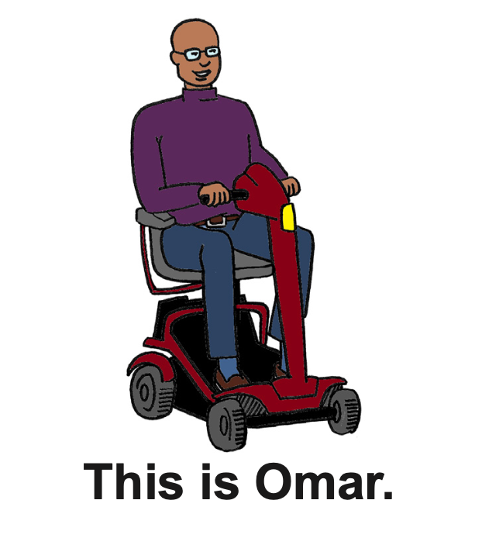
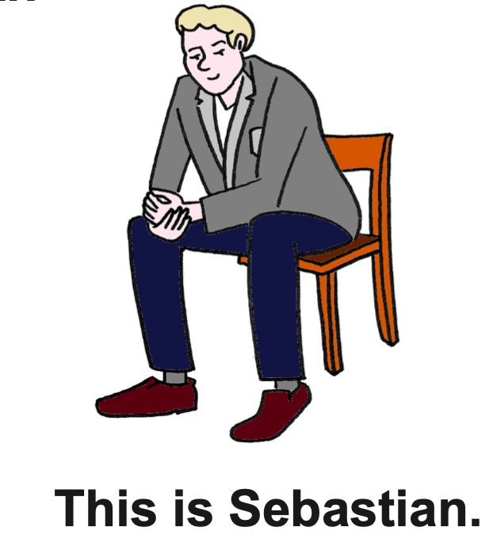
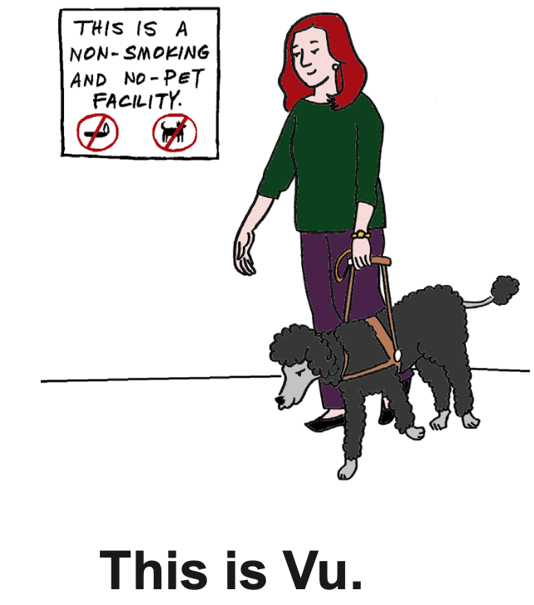
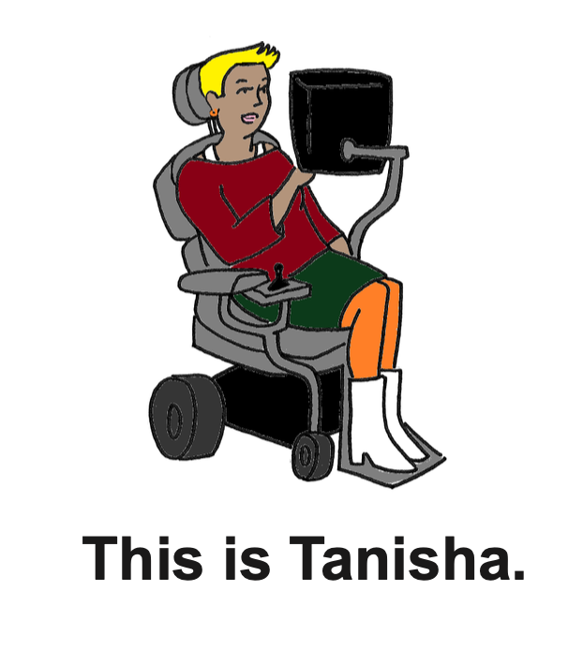
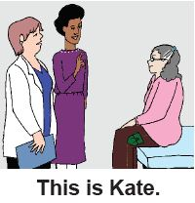
The following slides show 5 stories of people advocating for their accommodations
Option for discussion after each slide*

Slide 16
Omar advocated for what he needed. He asked the following questions:
Is the building accessible?
Is there an accessible exam table?
  If not, is there a Hoyer lift or transfer team?
Is the bathroom accessible and ADA compliant?
In the exam room is there enough room for me,
my wheelchair, and a support person?

Slide 17
Tanisha did the following steps to ensure a successful appointment:
Requested a longer appointment so that she’d have more time to communicate with the doctor
E-mailed the doctors office asking for the forms she would need to fill out so she could fill them out at home
Met with her support person before her appointment and programmed all her questions into her communication device
Asked the doctor to speak to her directly
At the end of the appointment, Tanisha asked the doctor to email her the summary of her visit and they set up her next appointment.

Slide 18
Sebastian did these things to prepare for this appointment:
Requested an exam room without bright lights or noises
Let the doctors office know that he would be bringing a support person
Wrote down several questions to ask his
doctor, with his support person
Practiced asking his doctor questions by role
playing with his support person.
During the appointment, Sebastian…
Reminded the doctor to speak directly to him
Asked the doctor his prepared questions

Slide 19
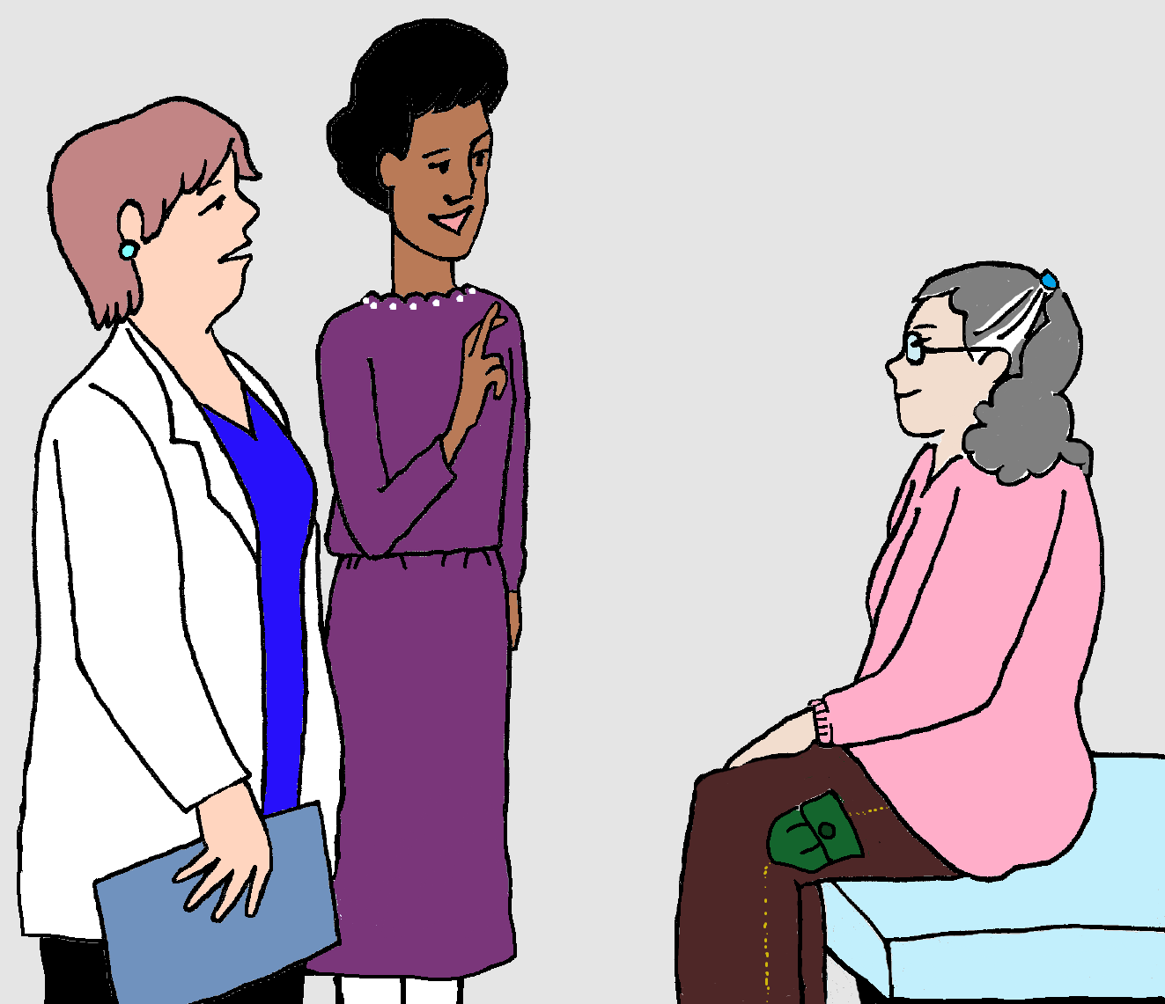
Kate took the following steps to ensure that her appointment was successful:
Used the telephone relay service to make her appointment
While making the appointment, she requested a qualified sign language interpreter that is medically qualified
Reminded the doctor to speak directly to her and not her interpreter
After the visit, Kate followed up with her doctor through email and asked a few more questions.

Slide 20
Vu has a good physical therapist appointment by doing the following:
Making sure that Rocket, Vu’s guide dog, stays close by Vu and does not make a mess in the hospital
Making sure that the physical therapist and staff know that they should not talk to, feed, pet, or play with Rocket

Slide 21
What did I learn?
I can take charge of my health care when I:
Know my rights under the ADA
Know what accommodations are best for me and how to ask for them
Know it is my right to tell my health professional what I need for a successful visit

Slide 22



Created in partnership with:
  Oregon Self Advocacy Coalition,
  Oregon Health and Science University, and
  Oregon Council on Developmental Disabilities
  Northwest ADA Center
The toolkit and its components were supported in part by the Grant or Cooperative Agreement Number DD000014, funded by the Centers for Disease Control and Prevention and by the University Center Excellence in Developmental Disabilities Administration on Community Living Grant #90DDUC0039-03-02. Its contents are solely the responsibility of the authors and do not necessarily represent the official views of the Centers for Disease Control and Prevention, Administration on Community Living, or the Department of Health and Human Services.

