Slide 1




Vulnerability in Caring for Others and Ourselves
Prof Maureen Kelley, PhD
Madeline Brill-Nelson Chair in Ethics Education
Center for Ethics in Health Care
Oregon Health & Science University

Slide 2
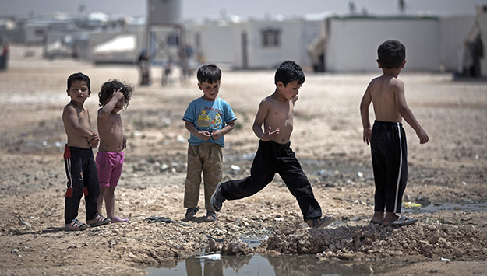
Vulnerability understood as…
Persons, families, groups who by virtue of their circumstance, or physical, social, political, or psychological conditions, may be especially susceptible to harms, ill-health, and coercion or exploitation by others.
Less able to protect their own interests and may be in need of greater protections.
Children in a Syrian refugee camp

Slide 3
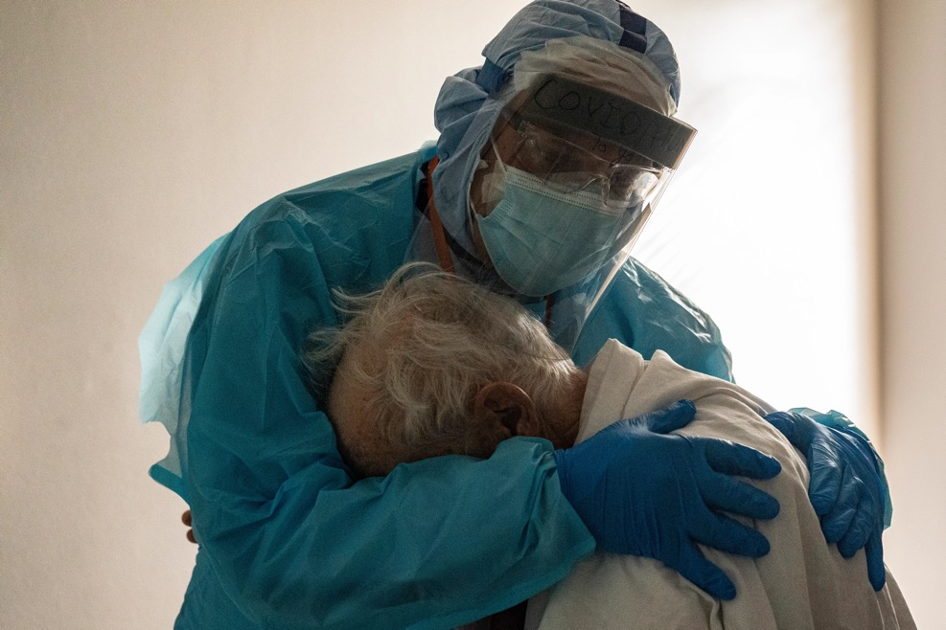
Illness is the great equalizer…
There is no time when we feel our own vulnerability more than when we or a loved one faces an illness. Whether acute or chronic, being sick reminds us of our mortality, our deep dependence on others, and our body’s fragility.

Slide 4
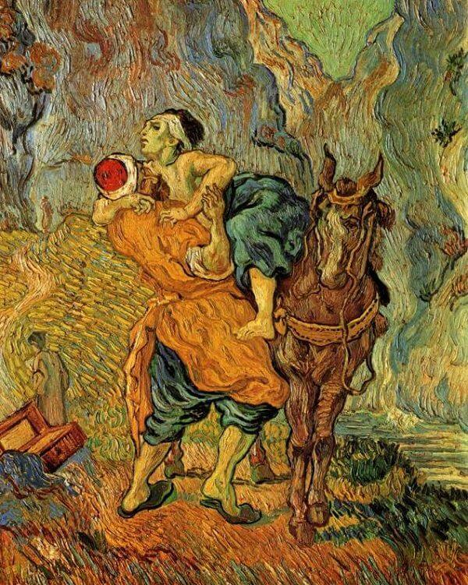
Deep moral roots in a “duty of rescue”
In medical ethics, a patient’s vulnerability creates moral obligations on behalf of those who need our help, who depend on our expertise, knowledge and care.
The Good Samaritan, 1890 by Vincent Van Gogh

Slide 5
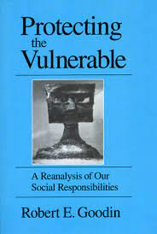
‘Vulnerability’ in medical ethics and research:
“At-risk" and duties of protection
“At greater risk for…”. Being susceptible to additional harms (Kottow 2004)
Increased potential that one’s interests cannot be protected (Agrawal 2003), or of incurring additional or greater wrong. (Hurst 2008)
  “Adding insult to injury”
Groups of people whose capacity to safeguard their own interests, through consent or refusal, is compromised. (Nickel 2006)
  Taking on more risk because no real choice to do otherwise

Slide 6
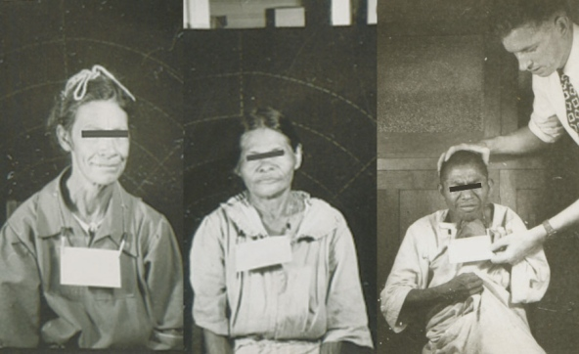
Moral roots in a History of Exploitation of Marginalized Persons & Groups
Prisoners
Children
Cognitively impaired persons
Students and employees
Military members
Ethnic minorities and Indigenous First Peoples
Economically and/or educationally disadvantaged persons
HIV/AIDS/HIV+ persons
Terminally ill persons
Older persons
Some guidelines recognize the added vulnerability of politically disenfranchised or stigmatized groups (e.g., MSM, sex workers. IV drug users)
Pregnant women, human fetuses and neonates (shift toward treating pregnant women as a “special population” but not vulnerable)
Guatemala STD experiments 1946-1948
Dr. John Cutler, physician with US Public Health service conducted STD experiments in Guatemalan prisoners, orphans, soldiers & patients at psychiatric hospital with 1,308 deliberately infected with STDs
Participants did not give consent

Slide 7
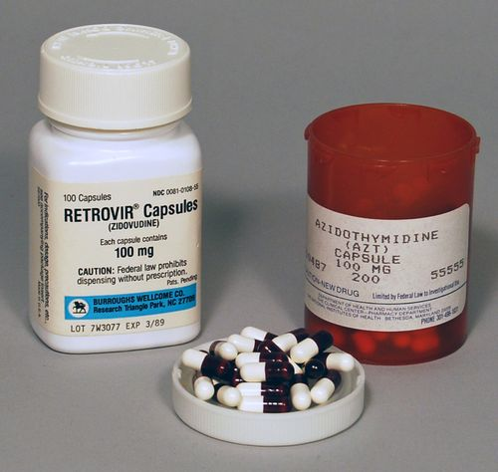
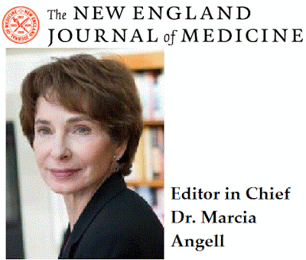
Contemporary exploitation: Early AZT Trials in Sub-Saharan Africa
1994 effectiveness of long-course AZT against vertical transmission of HIV from mother to infant demonstrated
Researchers began placebo-controlled clinical trials of short course AZT in Uganda, South Africa, Tanzania, Cote d'Ivoire, Burkina Faso, and Thailand
Some women randomized to a placebo-controlled arm, despite known effectiveness.
Editor of NEJM, Marcia Angell, compared the trial to Tuskegee.
Notes:
In 1994 effectiveness of long-course AZT against vertical transmission of HIV from mother to infant had been demonstrated in the AIDS Clinical Trial Group (ACTG) 076 study.
Concerned that the ACTG 076 regimen could not be implemented in resource poor settings, researchers subsequently began placebo-controlled clinical trials of short course AZT in Uganda, South Africa, Tanzania, Cote d'Ivoire, Burkina Faso, and Thailand.
Some women randomized to a placebo-controlled arm, despite known effectiveness.
Then editor of NEJM wrote a scathing commentary, arguing that the trial was unethical—standard of care ought to apply to control arm. Standard of care does not equal local standard of care.
She compared the trial to Tuskegee.
The editor of NEJM Marcia Angell argued: “Although I believe an argument can be made that a placebo-controlled trial was ethically justifiable because it was still uncertain whether prophylaxis would work, it should not be argued that it was ethical because no prophylaxis is the "local standard of care'' in sub-Saharan Africa. For reasons discussed by Lurie and Wolfe, that reasoning is badly flawed. [7] As mentioned earlier, the Declaration of Helsinki requires control groups to receive the "best'' current treatment, not the local one. The shift in wording between "best'' and "local'' may be slight, but the implications are profound. Acceptance of this ethical relativism could result in widespread exploitation of vulnerable Third World populations for research programs that could not be carried out in the sponsoring country. [14] Furthermore, it directly contradicts the Department of Health and Human Services' own regulations governing U.S.-sponsored research in foreign countries, [15] as well as joint guidelines for research in the Third World issued by WHO and the Council for International Organizations of Medical Sciences, [16] which require that human subjects receive protection at least equivalent to that in the sponsoring country. The fact that Whalen et al. offered isoniazid to the placebo group when it was found superior to placebo indicates that they were aware of their responsibility to all the subjects in the trial.”

Slide 8
What do historically marginalized or vulnerable populations share in common?
Captive audiences
Some had diminished capacity, literacy, or language
Lack of power or representation
Desperation and dependency
Lack of advocates/social support

Slide 9
What moral dimensions of vulnerability are often underappreciated?

Slide 10
The Story of Elena
16 year old girl living in an industrial town in Siberia.
Her father left when she was a baby. Her mother suffered from alcoholism and struggled to take care of Elena and her two brothers and would often leave them off at the orphanage for months at a time.
Elena aged out of the orphanage at 16 and lives on the streets and of and on in a shelter for teens and adults.
She has dropped out of school and makes a living as a sex worker in town.
Elena tells the counselor that “There is lot of competition now. “The best guys want the younger ones and you are more popular if you agree not to wear a condom. I do this for a little while and I save my money. I want to buy the pretty shoes in the magazine. And maybe I can get a job in the shops.”
In this region of Siberia there are extremely high rates of HIV, TB and drug resistant TB.
Elena is still HIV-negative but has active TB.
Elena is evaluated for DOTs – directly observed therapy – but there is concern she will not be adherent and “trackable”. The team worries this may contribute to Multiple Drug Resistant TB, both in Elena and in the region.
They are unsure how best to treat her TB.

Slide 11
Lesson One: Why we should move beyond the Good Samaritan:
How should we respond toward those in a vulnerable state?
How to respond - What is so often missing?
Recognition: Seeing them as a person, deserving of dignity and respect
Engagement: Engaging the person with respect and finding out how they are feeling, what they most need, what might be most helpful.
Compassion: Being mindful of how difficult circumstances may be, how difficult an offer of assistance might be.
Awareness of power differences and attempt to mitigate these.
Noticing the context and nuances
A variant on the Good Samaritan principle:
Duty to assist: If we are in a position to help and the right person to help, and our help is wanted, then we should help.

Slide 12
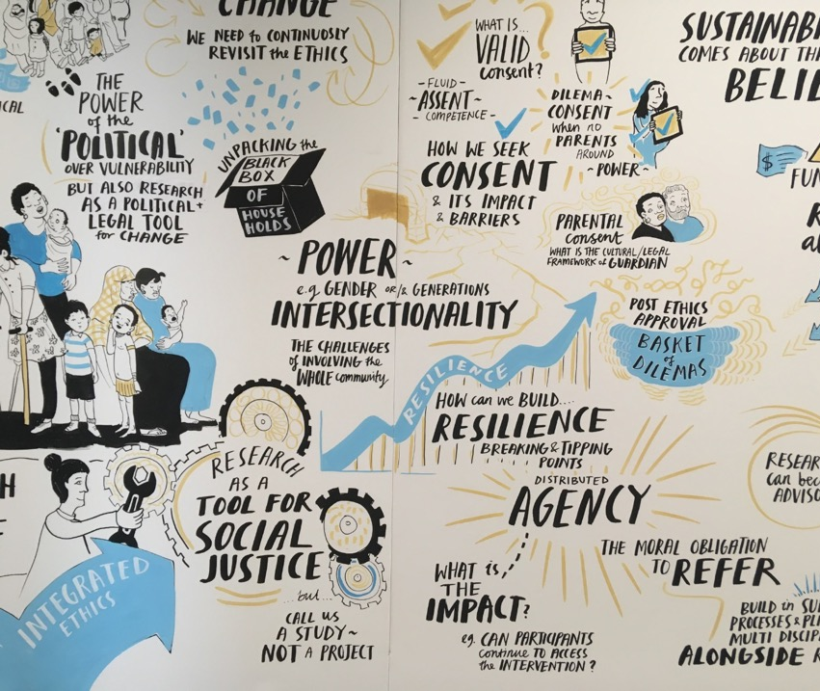
Balancing protection and respect for relational Agency
‘Do no harm’ not enough - duty to foster agency and autonomy (Lange et al., 2013)
The capacity of individuals, families and communities to act, make choices, shape their future and be self-determined even in the context of significant vulnerabilities.
  Acknowledging agency demonstrates respect for persons.
  Understanding and building on agency might identify strategies to reduce vulnerabilities and inequities.
(Hugmanet al., 2011)

Slide 13
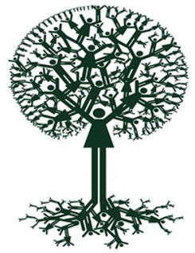
What do we mean by Agency?
Agency as relational: Deeply social - people “make decisions in context of their relationships, obligations, changing household and [crucially] their societal circumstances” (Crivello, Vu & Vennam 2014; Oswell 2016; Esser 2016)
Agency as constrained: “[agency] varies depending on opportunistic and constrained contexts, created and expected identities, positions of power, lifecourse stage, and state of emotions and wellbeing” (Robson et al. 2007)
  Agency as dynamic, situated, and contextual: not a universal experience; distributed across time, social networks and space; complex and contradictory (Abebe, 2019; MacLeod, 1992; Campbell & Mannell, 2016)
  Agency as ambiguous and value-laden (Bordonaro and Payne, 2012)
Notes:
It is a deeply social concept: often depends on social support.
Examples:
Women’s social capital
Peer support for young people without parents

Slide 14

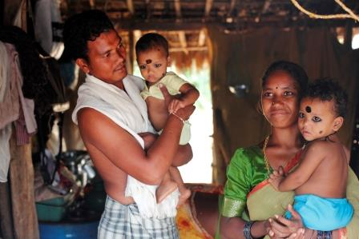
Relational Agency
Assumption of the ‘autonomous’ actor
Girl Effect: Girls = exceptionally vulnerable AND uniquely powerful
Little resemblance to children and young people’s realities
Agency not an individual ‘trait’ – agency (and vulnerability) depend upon other people and the power relationships between these persons.
“Young people ‘make decisions in context of their relationships, obligations, changing household and [CRUCIALLY] their societal circumstances.” (Crivello, Vu & Vennam 2014)
India: Educating young men and women about contraception and early parenthood seen as enhancing agency, but in context where decisions about fertility are influenced by family and community, effectiveness of these efforts is inhibited.

Slide 15
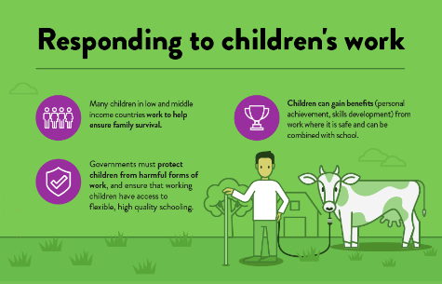
Constrained Agency
Children and young people are able to exercise agency differently under different circumstances
Agency as ‘thicker’ or ‘thinner’ over time, space and across different relationships
Continuum of agency – depends on opportunities and constraints, created and expected identities, positions of power, lifecourse stage, and emotions and wellbeing” (Robson et al. 2007)
Examples:
Children’s work in Ethiopia – choice under extremely constrained financial circumstances to provide for family and improve future employment prospects.
Young women exercise agency in India by opting for sterilisation after 2nd birth, though the choice is thin since there a few other ways for them to have control over reproductive choices.

Slide 16
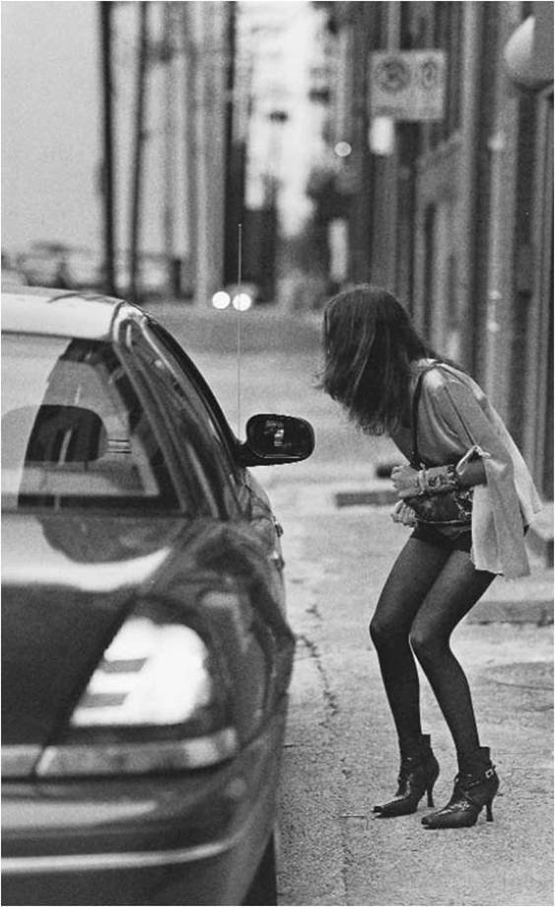
Lesson Two: Context is Everything
Vulnerable to what? Capable of what? What can be done?
Diagnosing vulnerability
What are the specific vulnerabilities that Elena has in this context, at this time?
What are the immediate and structural sources of these vulnerabilities?
Developing a strategy for responsible response
What agency, capacities and sources of support might she have?
How might research/ researchers mitigate the risks she experiences or connect her to support?

Slide 17
Lesson Three: Problems with labeling ‘vulnerable populations’?
All or nothing: leads to unjust exclusion within groups
Too narrow: reduces vulnerability to capacity to consent
Too broad: empty meaning, fails to address
  context specific and situational nature of vulnerability
  sources of vulnerability
  degrees of vulnerability
Stigmatising: leads to stereotypes and discrimination
Paternalistic: fails to respect persons, insulting, overprotective
Blind spots: Hidden vulnerabilities in otherwise “regular” populations?
(Rogers, MacKenzie, Dodds 2016)

Slide 18

The problem of exclusion
Example: Pregnant Women
Pregnant women are often considered ‘vulnerable’ and routinely excluded from clinical trials by default
Consequently, very little is known about whether routine medicines or vaccines are safe for them to use
But: Sick women get pregnant and pregnant women get sick! (Maggie Little, Georgetown University)
The COVID-19 Pandemic has highlighted the issues for research in pregnancy and the the need to overcome barriers to inclusion

Slide 19
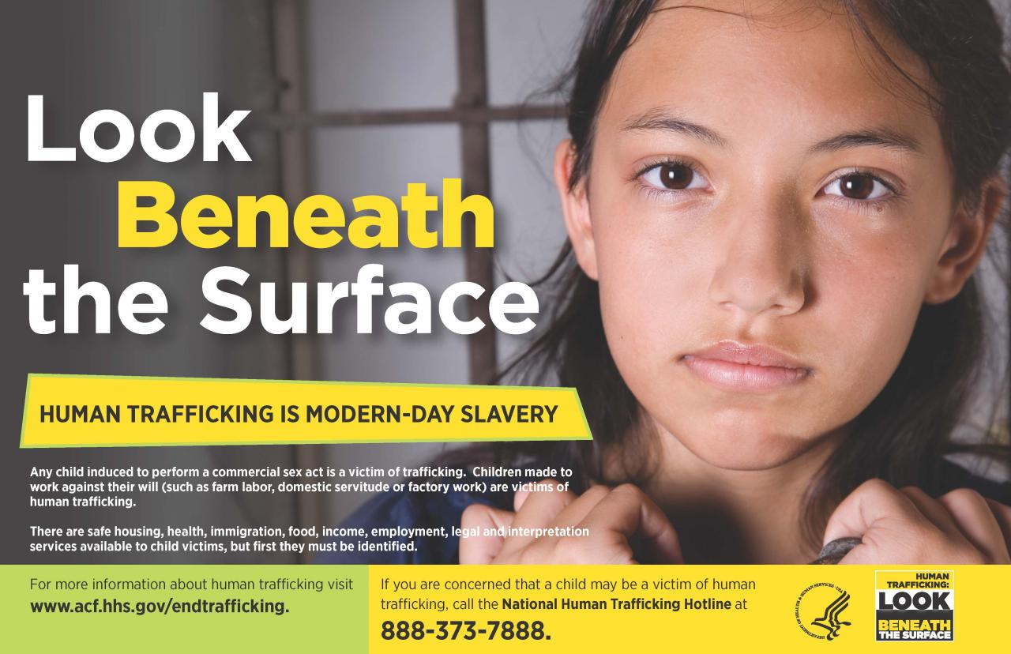
Lesson Four: Vulnerability is layered, intersectional and often has structural causes

Slide 20
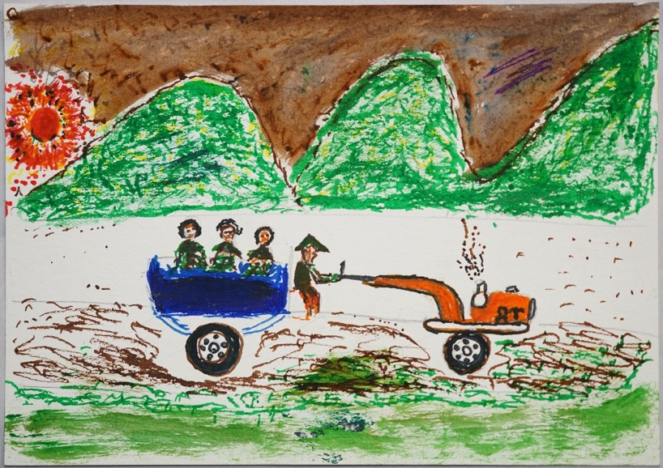

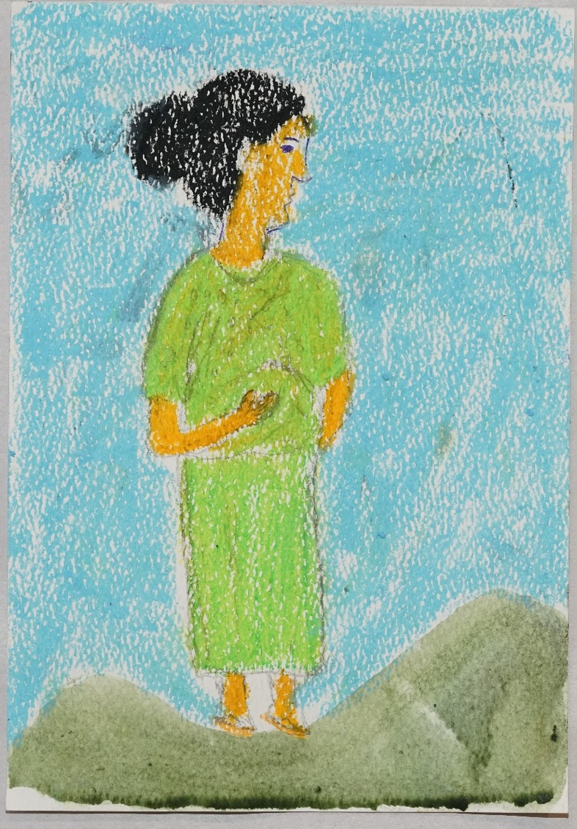
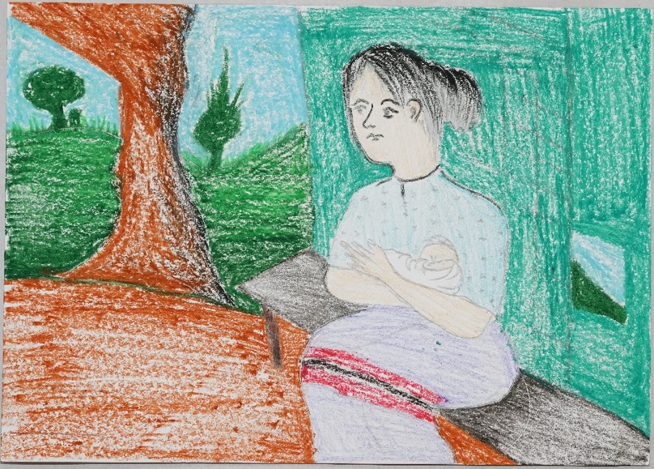
Migrant women’s experiences of structural vulnerabilities in daily living at the Thai-Myanmar border

Slide 21
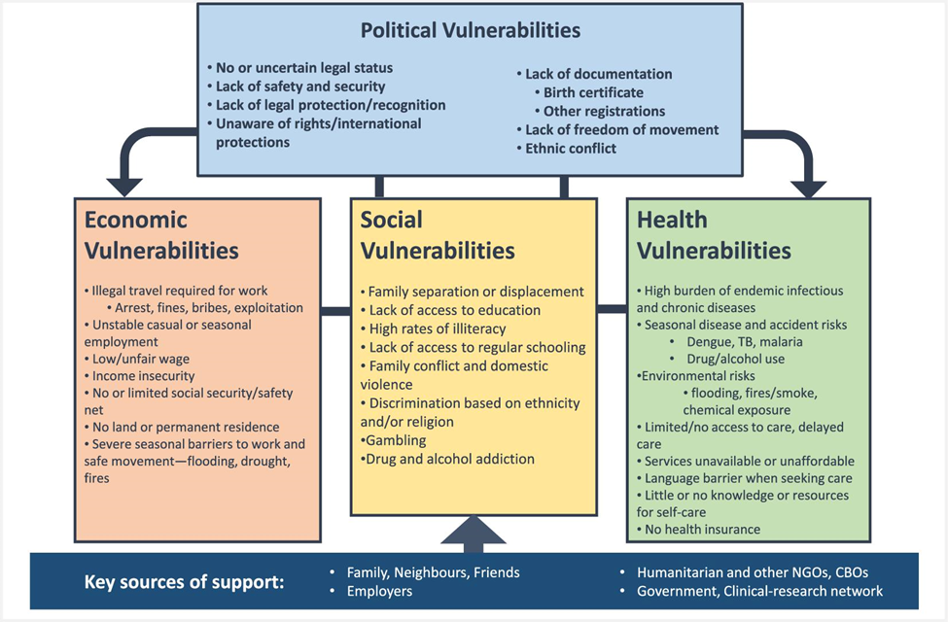
Daily experience of layered vulnerabilities, with structural drivers, but also agency & resourcefulness
Khirikoekkong et al., “Research ethics in context: Understanding the vulnerabilities, agency and resourcefulness of research participants living along the Thai-Myanmar border”, International Health 12(6): 551–559. 2020.

Slide 22
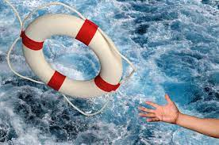
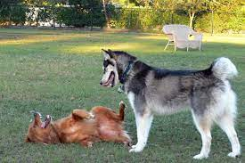
Lesson Five – It is essential to consider power relations when we think about vulnerability and our responses
Vulnerability as Victim in Need of Rescue
Making Oneself Vulnerable – Vulnerability as Bravery

Slide 23
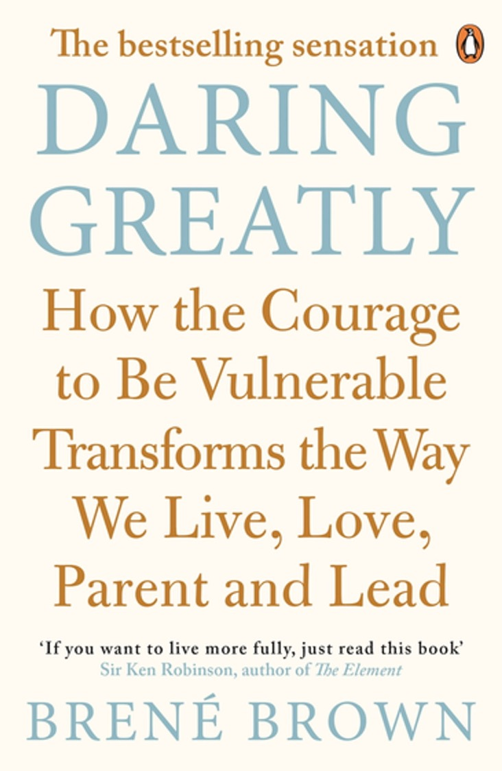
“Daring greatly means the courage to be vulnerable. It means to show up and be seen. To ask for what you need. To talk about how you’re feeling. To have the hard conversations.”
“I define vulnerability as uncertainty, risk, and emotional exposure. With that definition in mind, let’s think about love. Waking up every day and loving someone who may or may not love us back, whose safety we can’t ensure, who may stay in our lives or may leave without a moment’s notice, who may be loyal to the day they die or betray us tomorrow—that’s vulnerability.”
“Staying vulnerable is a risk we have to take if we want to experience connection.”
“Courage starts with showing up and letting ourselves be seen…There’s a crack in everything. That’s how the light gets in.”

Slide 24
“I want our home to be a place where we can be our bravest selves and our most fearful selves. Where we practice difficult conversations and share our shaming moments from school and work. I want to look at Steve and my kids and say, ‘I’m with you. In the arena. And when we fail, we’ll fail together, while daring greatly.’ We simply can’t learn to be more vulnerable and courageous on our own. Sometimes our first and greatest dare is asking for support.”

Slide 25
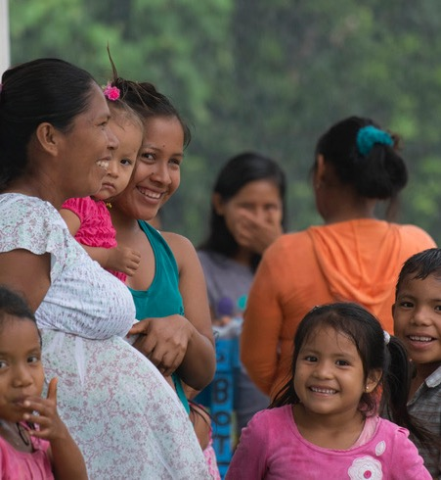
Judith Butler
Vulnerability in Resistance: Agency and gender violence
Acts of resistance are limited in remote rural communities (e.g. little access to services, social norms that condone violence)
Trying to shift space and social networks to create the possibility for acts of resistance
Requires tackling gender violence at the level of the community rather than the level of the individual; maintaining community solidarity
Through this process, ‘acts of resistance’ thereby become acts against the historical and cultural vulnerabilities that drive gender violence (e.g. exclusion from social services)
Dr Jenevieve Mannell University College London (UCL)
Preventing gender-based violence in the Peruvian Amazon

Slide 26
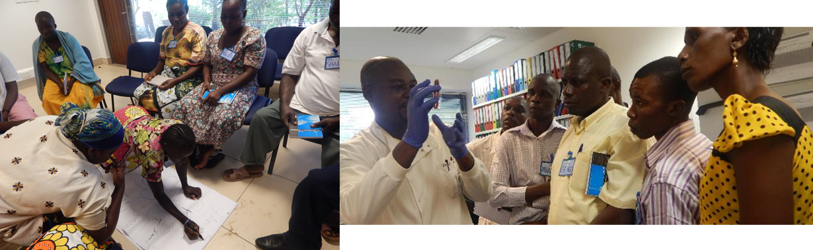
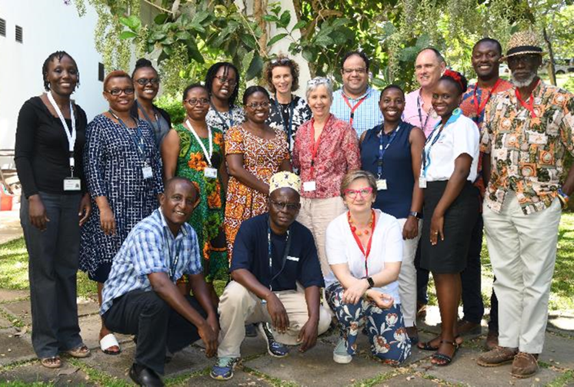
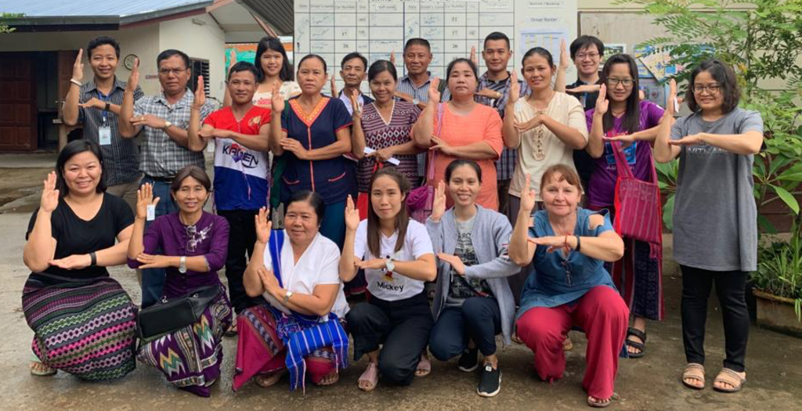
Our work in Mae Sot and Kenya:
Power and solidarity in grass roots activities
KEMRI Community Representatives, and the Community engagement Advisory group (Kenya)
T-CAB meeting, 30 Aug 2019

Slide 27
Closing thoughts…
Being vulnerable, and even making ourselves vulnerable to others requires courage, but it is important to recognize this may assume a position of relative privilege.
Caring respectfully for those who are vulnerable requires mindfulness of context, engagement, and compassion.
Viewing another person as vulnerable can also risk overlooking their strength, resilience, and capacity for action and choices in their life.
Our power and strength are deeply social and communal

