Slide 1
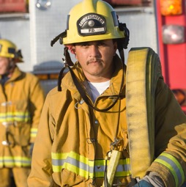
Oregon Healthy Workforce Center
The Oregon Healthy Workforce Center has been a NIOSH Total Worker Health® Center since 2011.
Current Theme: Total Worker Health intervention effectiveness, translation, and outreach to advance safe and healthy work design
NIOSH grant: U19OH010154; 2021-2026

Slide 2
Conduct Research
What We Do
Examine occupational health through the lens of biomedical and workplace research
Develop and Disseminate Tools and Training
Convert research into evidence-based tools and training that workplaces use to improve occupational health and safety
Collaborate with Partners
Collaborate with state, regional and national partners on research and adoption, implementation and evaluation of evidence-based practices
Deliver Educational Programming
Design and deliver courses and symposia that expand the application and knowledge of Total Worker Health principals in Oregon and the Pacific Northwest

Slide 3
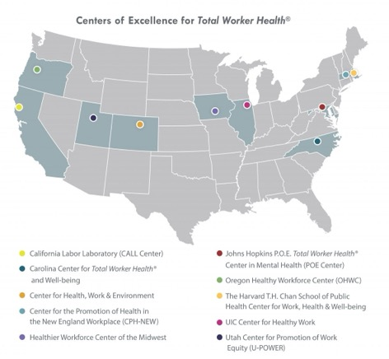
THE INSTITUTE CONDUCTS TOTAL WORKER HEALTH RESEARCH, AND PROVIDES WORKERS AND EMPLOYERS WITH EDUCATION, RESOURCES AND TECHNICAL ASSISTANCE TO IMPLEMENT BEST PRACTICES
Workplace Impact
NIOSH Center of Excellence
Since 2011, the Oregon Healthy Workforce Center has been designated as a National Institute for Occupational Safety and Health (NIOSH) Center of Excellence for Total Worker Health® for the Pacific Northwest.
Oregon Total Worker Health Alliance
Formed in 2017, the Oregon Total Worker Health Alliance is a state-wide partnership between the Institute, Oregon OSHA, and SAIF Corporation to bring excellence in the application of Total Worker Health to organizations throughout Oregon.
Occupational Public Health Program
A NIOSH-funded partnership with Oregon Health Authority to conduct statewide occupational health surveillance research and fatality investigations.

Slide 4
Research-to-Practice
APPLIED RESEARCH IMPACT

Slide 5
Workplace Mental Health Training For Managers
SUCCESS METRICS:
2,000 training seats licensed by federal and state agencies, universities and private organizations
Training adopted by nine Oregon state agencies
Training available to 45,000 State of Oregon employees on Workday
Addressing the widespread increase in work-related stress and poor employee mental health
TRAINING PURPOSE
Workplace Mental Health Training for Managers is an evidence-based, online program that teaches managers and supervisors to:
Promote positive employee mental health
Respond appropriately to employee warning signs
Reduce employee loneliness and anger through practical strategies
INTENDED AUDIENCE
Managers and supervisors in a variety of organizational settings

Slide 6
COMPASS
SUCCESS METRICS:
Adopted by the Oregon Home Care Commission
Available to 60% of home care workers in Oregon
651 home care workers have participated in the training, including 110 in 2024
Training available in Spanish, Russian, Mandarin, Cantonese and Vietnamese
The Community of Practice and Support for Home Care Workers (COMPASS) program develops, assesses and provides tools to protect the health and safety of home care workers.
TRAINING PURPOSE
The COMPASS toolkit utilizes a peer-led social support group format designed to improve social well-being, reduce the risk of injuries, and promote health among home care workers. Home care workers learn together, set goals, and receive support for making changes to advance safety, health and well-being at work.
INTENDED AUDIENCE
Oregon Home Care Commission, SEIU, Home Care Workers

Slide 7
Safety Climate Scale
SUCCESS METRICS:
Measuring and scoring a company’s safety climate to support lower injury rates, lower workers’ comp claims, and higher job satisfaction.
Since 2020, the Safety Climate Scale has been implemented at 16 Oregon companies surveying nearly 4,000 workers
Safety Climate Scale utilized in partnership with SAIF Corporation to scientifically validate the Ansbro Safety Culture Spectrum and shorten it to a 10-item survey for more efficient stakeholder implementation by SAIF consultants
TRAINING PURPOSE
The Scale assesses safety by surveying workers about management’s commitment to and support of safety and health. This provides critical information for organizations to make focused adjustments to safety management and improve safety culture.
INTENDED AUDIENCE
SAIF Corporation, construction, manufacturing and transportation industries
IMPACT BEYOND OREGON
The scale has been implemented beyond Oregon as of 2024, reaching various states across the U.S. and several Asian and African countries.

Slide 8
WORKPLACE MENTAL HEALTH TRAINING
"This program meets our managers' needs and strengthens our commitment to a supportive workplace. The training and the responsive OHSU team have made it easy for us to provide science-based and validated resources for our supervisors. We have received positive responses from our supervisors after deploying the training, and I look forward to the long-term positive mental health impacts that this validated training provides for our workforce."​
​
Dr. Christian B. Rathke, Director, Total Worker Health Program,​ National Environmental Satellite, Data, and Information Service, National Oceanic and Atmospheric Administration
What our clients say
“I think anybody new coming into this field should have to take the COMPASS class. If you are brand new… you should have to take this class, because it will help exponentially."
COMPASS training participant
SAFETY CLIMATE SCALE
“I’d recommend that any company, no matter what size and no matter what level of safety maturity, measure their safety climate with the OHSU team. They are the experts and they draw from a wealth of data that most of us don’t have access to. It will help your company. Be brave ...listen to the findings, and take action.”​
​
Demetra Star, Safety Team Leader, Fortis

Slide 9
EXPANDING REACH THROUGH
Programs & Partnerships

Slide 10
NIOSH-funded Programs
OREGON HEALTHY WORKFORCE CENTER
The Institute has secured
Total Worker Health® research and intervention
NIOSH-funded, national center of excellence in Total Worker Health
10+ associated research/implementation partnerships
$15.7M in funding since founding since 2011
$20 Million
in National Institute for Occupational Safety and Health (NIOSH)-funded programming
over two decades
OREGON OCCUPATIONAL PUBLIC HEALTH PROGRAM
Occupational surveillance and fatality investigations
NIOSH-funded, state-wide workplace safety surveillance center
Partnership with Oregon Health Authority
Tracking, identifying and preventing workplace injuries, illnesses and deaths in Oregon

Slide 11
State Partnerships
TOTAL WORKER HEALTH ALLIANCE
Total Worker Health practitioner education
State-wide Total Worker Health® education initiative
Partnership with SAIF Corporation and Oregon OSHA
Delivering Total Worker Health education since 2018
Curriculum delivers 7 different courses
The Institute’s expertise in Total Worker Health is drawing in new partners and industries, expanding reach and impact throughout the state of Oregon and beyond
RESPECTFUL WORKPLACE INITIATIVE
Total Worker Health for the construction industry
Solutions for retaining a diverse workforce in Oregon’s construction industry
Partnership with Oregon Department of Transportation and the Oregon Bureau of Labor and Industry
$800,000 in funding since 2022
Notes:
s

Slide 12
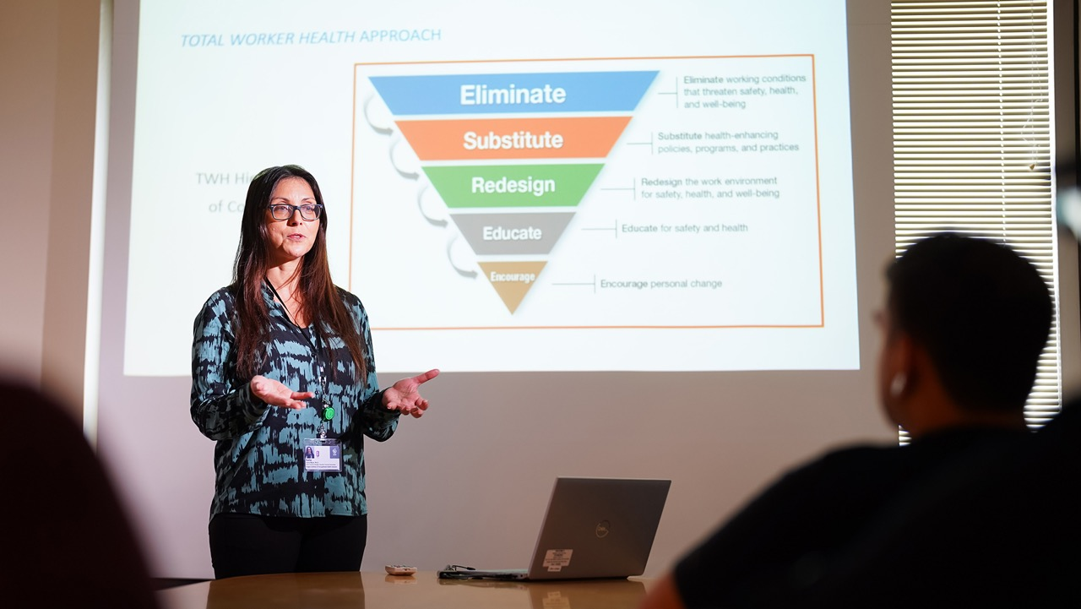
RESEARCH-TO-PRACTICE
Total Worker Health® Education
EXPANDING APPLICATION OF TOTAL WORKER HEALTH KNOWLEDGE IN OREGON AND THE PACIFIC NORTHWEST

Slide 13
Total Worker Health® Education & Capacity Building
Our Education Partners

Slide 14
Total Worker Health Education & Capacity Building
Total Worker Health® Alliance
Total Worker Health Alliance Curriculum
SUCCESS METRICS:
3 Hours
Total Worker Health 101: The Basics
1 Hour
Total Worker Health Awareness Workshop
3 Hours
Total Worker Health Workplace Solutions
90 Minutes
Total Worker Health for Safety Committees
8 Hours
Total Worker Health Train the Trainer
Development of introductory Total Worker Health® Curriculum in partnership with SAIF Corporation
50+ Total Worker Health courses delivered in Oregon since 2019
Seven to 10 courses offered per year
1,500+ occupational health safety partitioners enrolled and completed Total Worker Health Alliance courses

Slide 15
Total Worker Health® Education & Capacity Building
Exhibits and Conferences
University of Washington Total Worker Health Certificate
Institute Bi-Annual Symposia
SUCCESS METRICS:
SUCCESS METRICS:
SUCCESS METRICS:
Development of advanced Total Worker Health curriculum for working professionals
30+ students matriculated since 2023
Expanding Total Worker Health education opportunities beyond the state of Oregon
Average symposium – 100+ attendees
Symposia quality ranked 4.7/5
78% of symposia attendees report likelihood of making changes in their workplaces
82% of symposia attendees report clear understanding of research-to-practice
Consistent demand to present and host exhibit booths at practitioner-oriented conferences throughout Oregon and the Pacific Northwest
Institute Outreach Team attends 10-12 conferences each year
Conference attendee engagement approximately 1,500 individuals/year

Slide 16
What our clients say
TOTAL WORKER HEALTH® ALLIANCE
“I thought the TWH series was wonderful, and I hope to have the chance to tell others about it. It was refreshing to hear from others who have implemented TWH how it has positively impacted their organization. The instructors are extremely knowledgeable and had immediate answers for all questions asked.” ​
​
TWH 101 participant: July 2023
“Loved the introduction and concept. Really encouraged to partner with our (diversity, equity, and inclusion), human resources, and values department to understand next steps.” ​
​
TWH 101 participant: March 2023
INSTITUTE SYMPOSIUM
"Another incredible symposium. Taking the audience on a journey from introduction of the topic, through various deeper aspects of it to a final resolve, understanding and a feeling of a positive future. Thank you!" ​
​
2019 in-person event participant

Slide 17
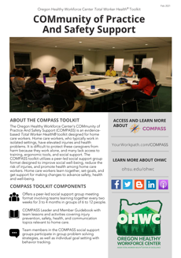
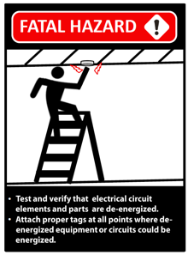
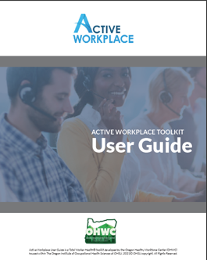
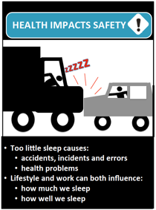
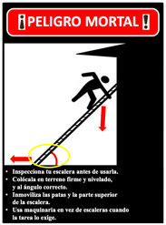
§c
Digital Resources & Engagement
100+ digital workplace health and safety resources available for download
2024 WEBSITE VIEWS
20,000+
2024 SOCIAL MEDIA
12,000+ FOLLOWERS
STREAMING CONTENT
90,000+ TOTAL PLAYS
NEWSLETTER SUBSCRIBERS
16,000+

Slide 18
Oregon Healthy
Workforce Center
Contact:
Leslie Hammer, Ph.D. (Center Director)
hammerl@ohsu.edu
Thank You!

